Slide 1

DSL-OTA: Distributed Swarm Learning with Over the Air Aggregation on Non-i.i.d. data
Zhuoyu Yao, Yue Wang
Computer Science
Georgia State University, Atlanta, GA, USA
Mar 7, 2025
Notes:
Hello

Slide 2
Outline
Background
Existing research
Proposed design and method
Preliminary results
Summary and future work

Slide 3
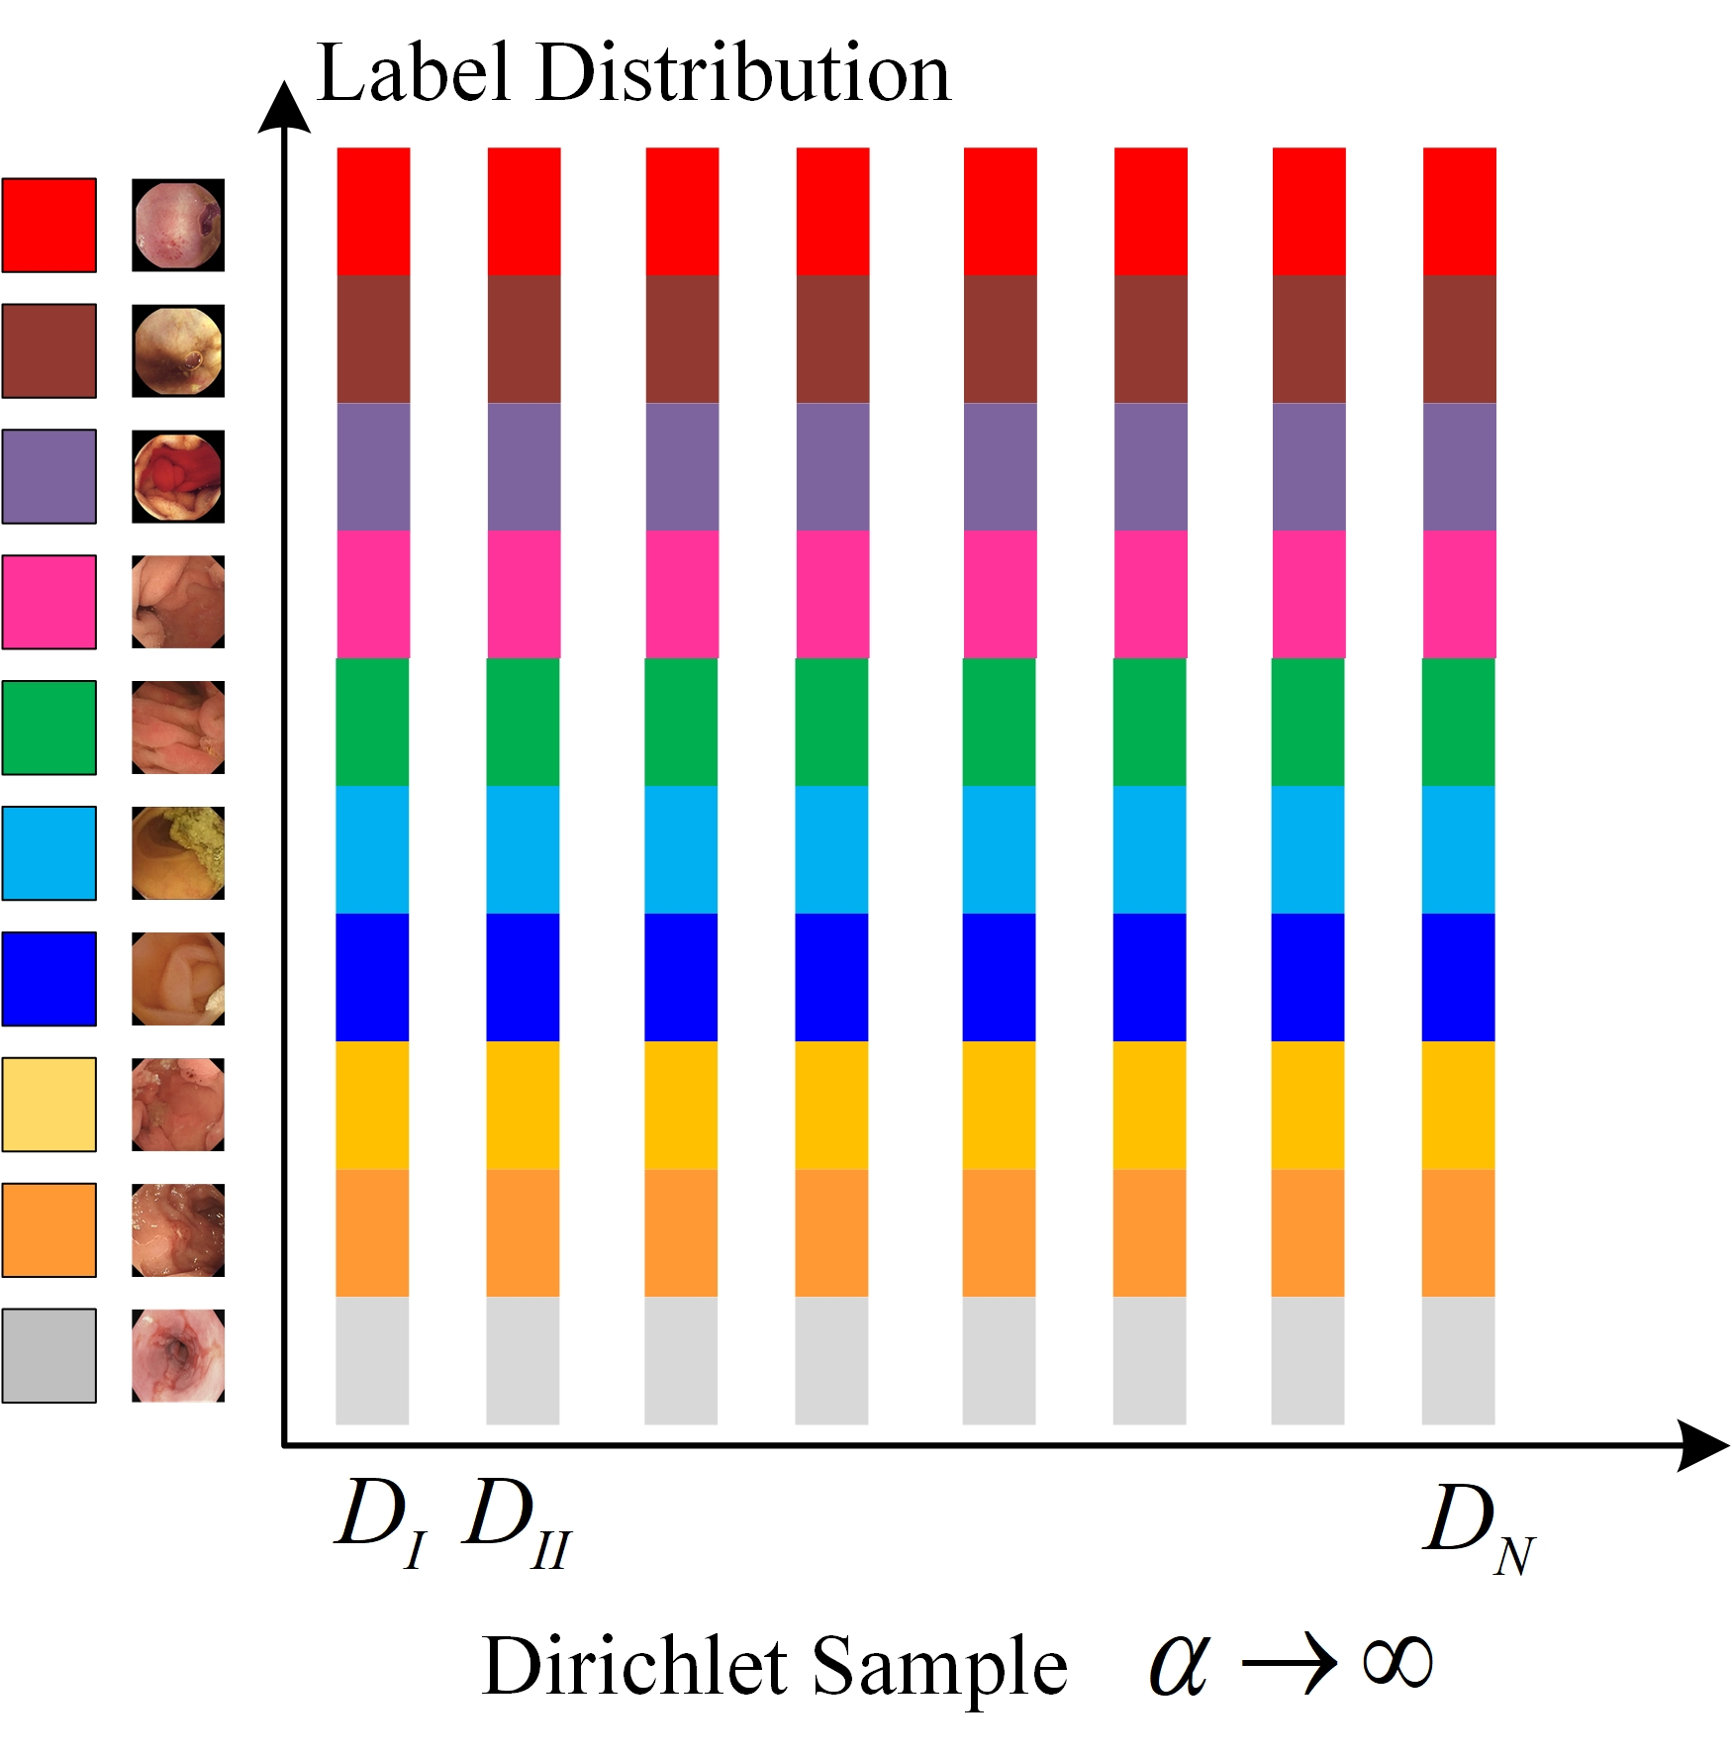
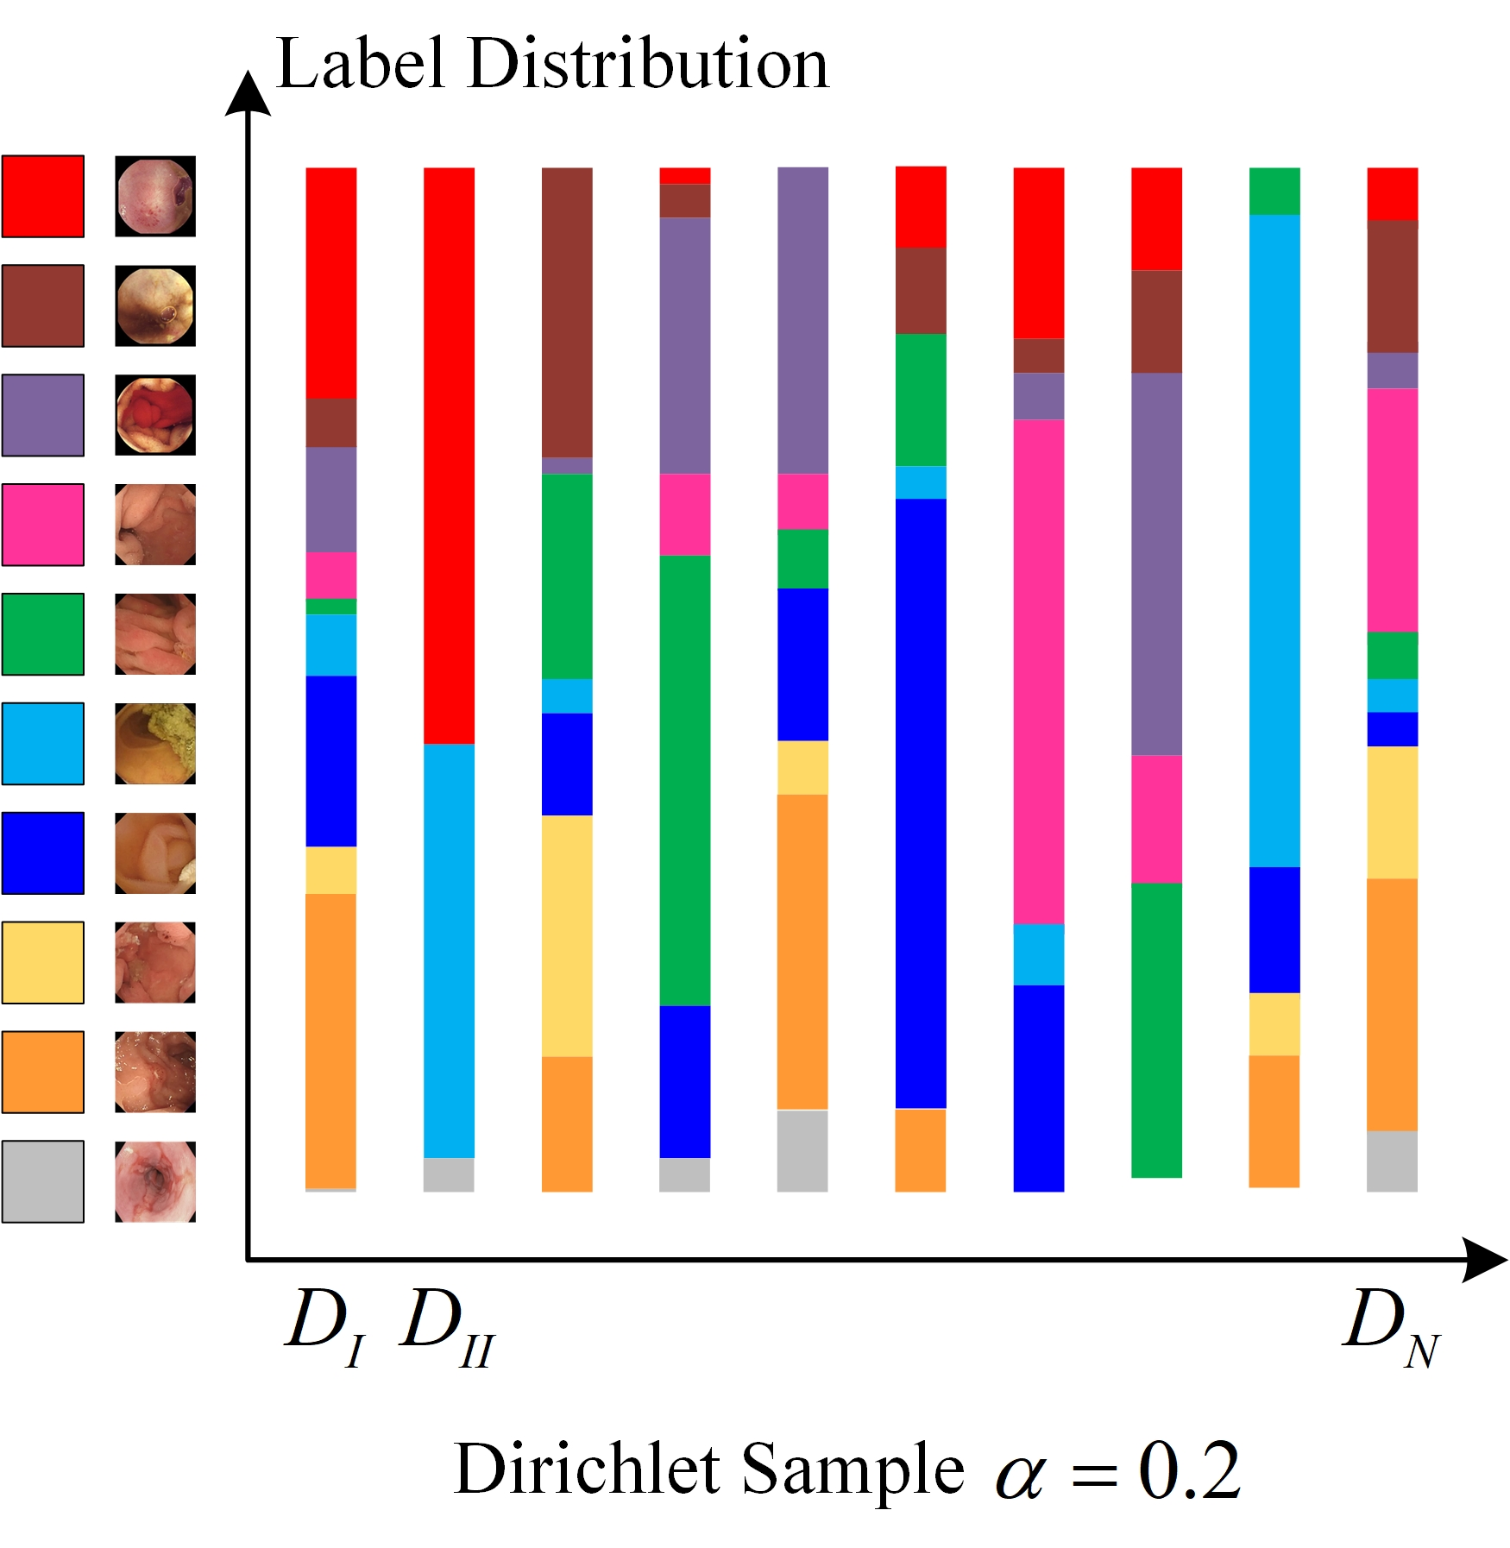
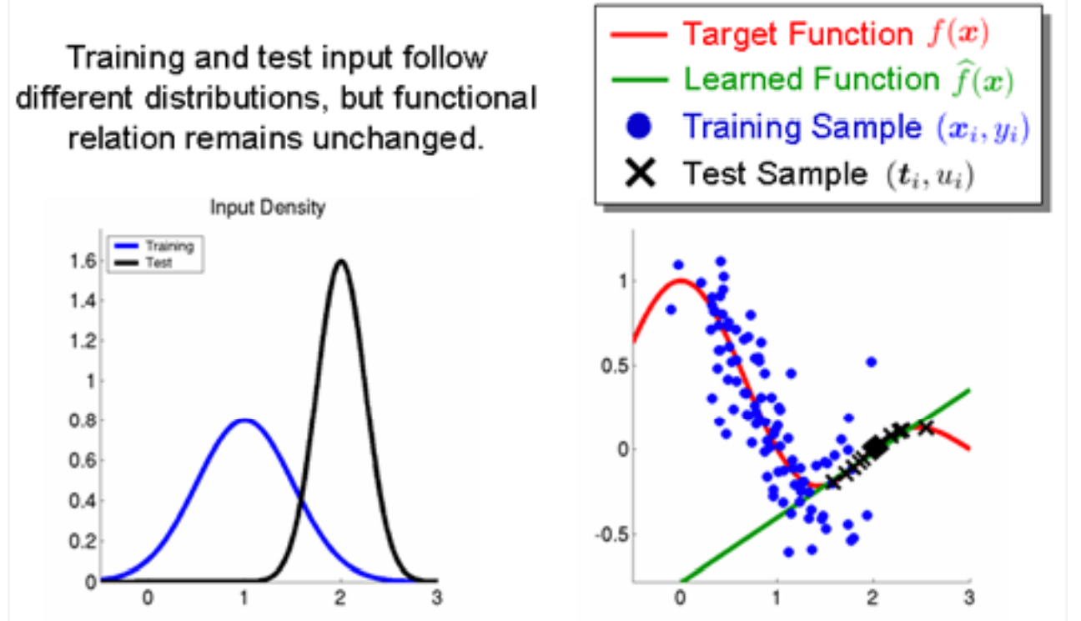
Background – Non-i.i.d. datasets
Non identically and independently distributed datasets
How will model performance change?
Performance deterioration
Overfitting
Cannot convergent
uniform data distribution
unbalanced data distribution

Slide 4
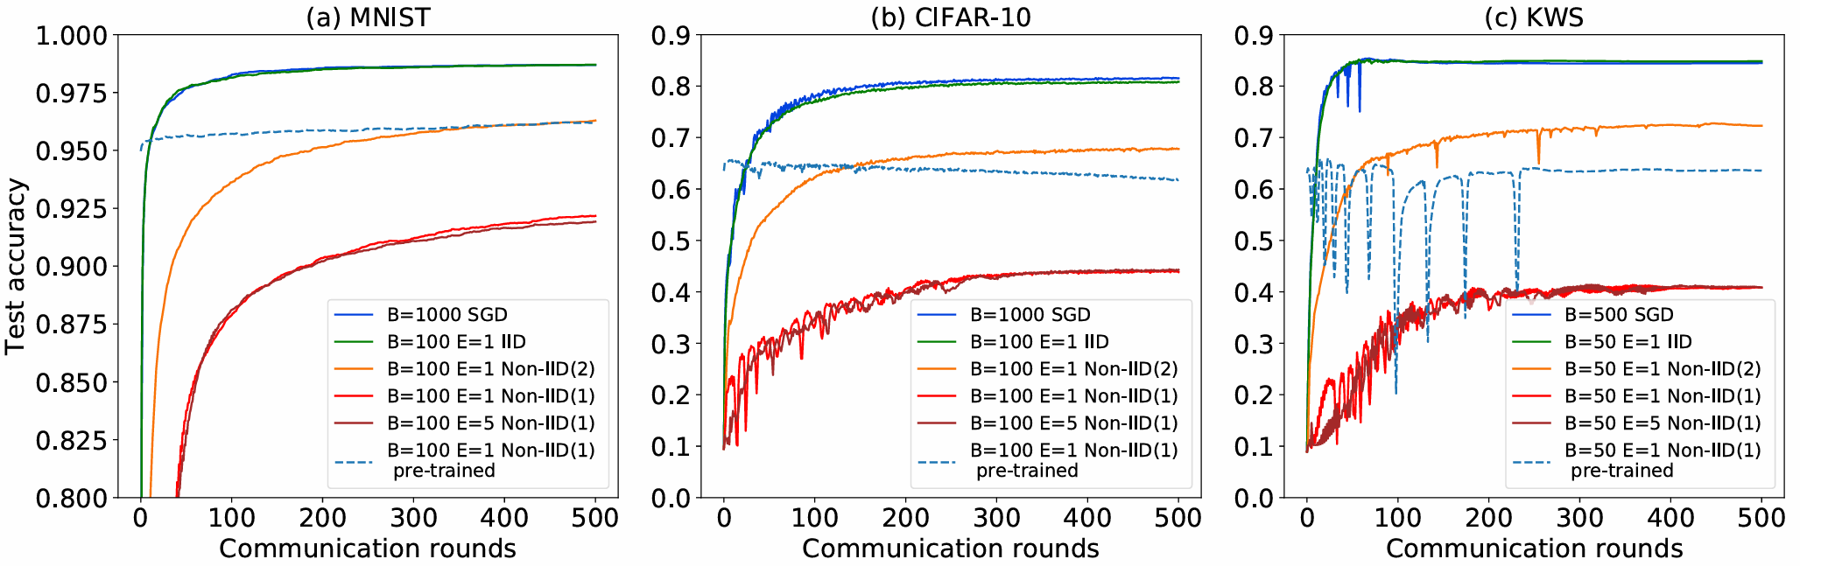
Background – Why Non-i.i.d. Harmful?
Basic Assumption of Centralized ML: i.i.d. batches
Incomplete understanding and over-simplification
Partial characterization
Bias solution
Gradient-based optimization
Non-i.i.d. is more serious in Distributed ML.
Non-i.i.d. dataset is common
Got worse results while collaboration
Notes:
Because of the expensive cost of data aggregation, researchers introduce distributed ML

Slide 5
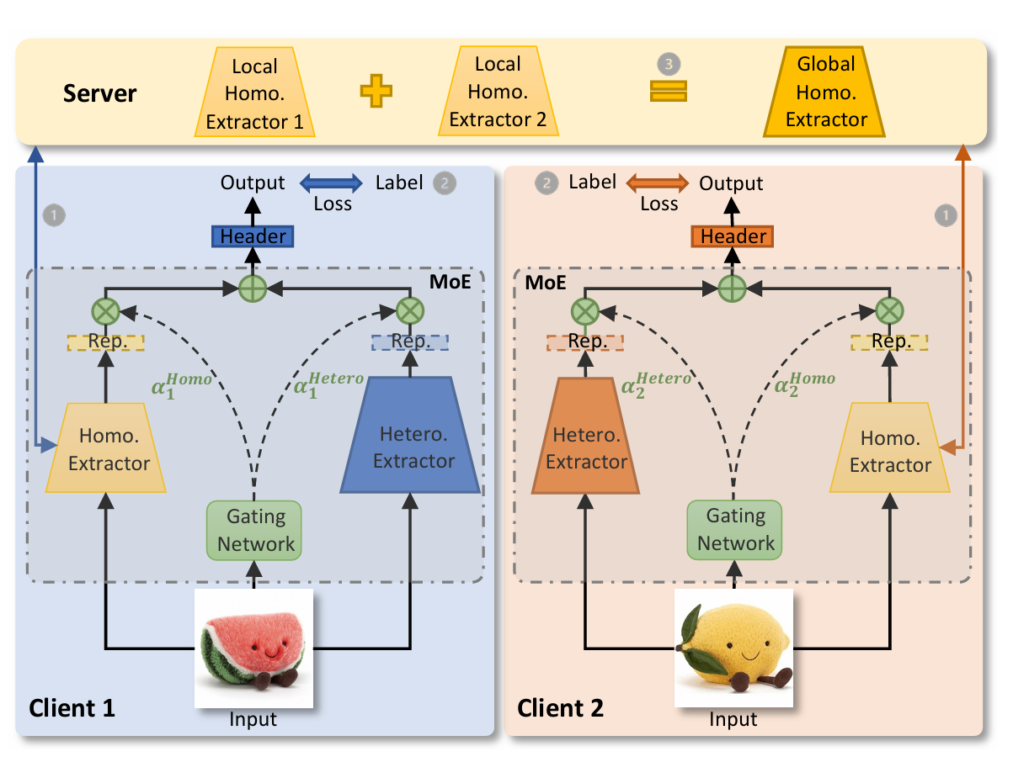
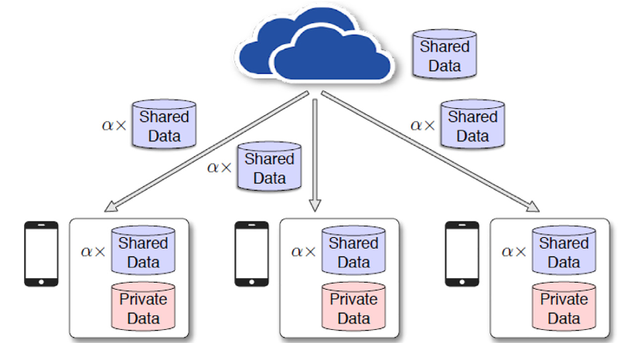
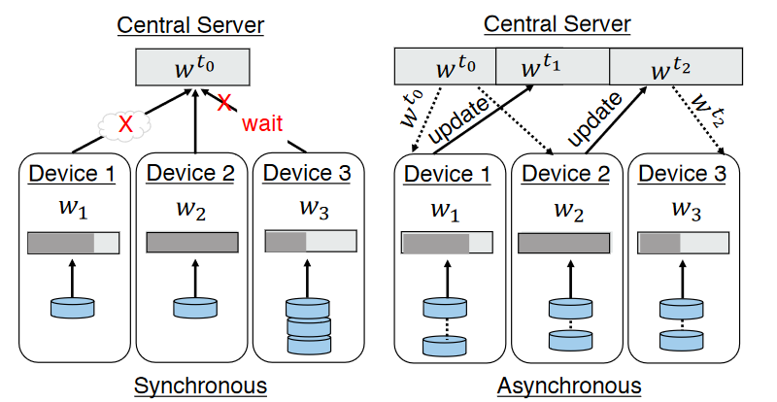
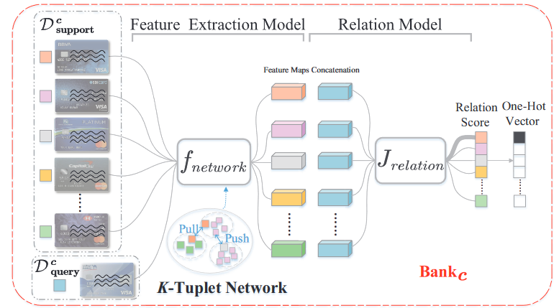
Background – FL & Non-i.i.d. study
SOTA methods:
Data-based: data sharing ^{[1]}, data enhancement ^{[2]}
Model-based: adaptive optimization ^{[3]}, model aggregation ^{[4]}
Algorithm-based: meta learning ^{[5]}, multi-task learning ^{[6]}
Framework-based: clustering ^{[7]}, personalization layer ^{[8]}
Data Sharing
Model Aggregation
Meta Learning
Personalization MoE
[1] Zhao Y, Li M, Lai L, et al. Federated learning with non-iid data[J]. arXiv preprint arXiv:1806.00582, 2018.
[2] Shin M J, Hwang C, Kim J, et al. Xor mixup: Privacy-preserving data augmentation for one-shot federated learning[J]. arXiv preprint arXiv:2006.05148, 2020.
[3] Wang Y, Tian Z, Fan X, Cai Z., et al. Distributed swarm learning for edge internet of things[M]. IEEE Communications Magazine, 2024.
[4] Chai Z, Chen Y, Anwar A, et al. FedAT: A high-performance and communication-efficient federated learning system with asynchronous tiers[C]//Proceedings of the international conference for high performance computing, networking, storage and analysis. 2021: 1-16.
[5] Zheng W, Yan L, Gou C, et al. Federated meta-learning for fraudulent credit card detection[C]//Proceedings of the Twenty-Ninth International Conference on International Joint Conferences on Artificial Intelligence. 2021: 4654-4660.
[6] Ma Q, Xu Y, Xu H, et al. FedUC: A unified clustering approach for hierarchical federated learning[J]. IEEE Transactions on Mobile Computing, 2024. [7] Han P, Huang C, Tian G, et al. Convergence analysis of split federated learning on heterogeneous data[J]. Advances in Neural Information Processing Systems, 2025, 37: 103476-103544..
[8] Yi L, Yu H, Ren C, et al. pFedMoE: Data-level personalization with mixture of experts for model-heterogeneous personalized federated learning[J]. arXiv preprint arXiv:2402.01350, 2024.

Slide 6
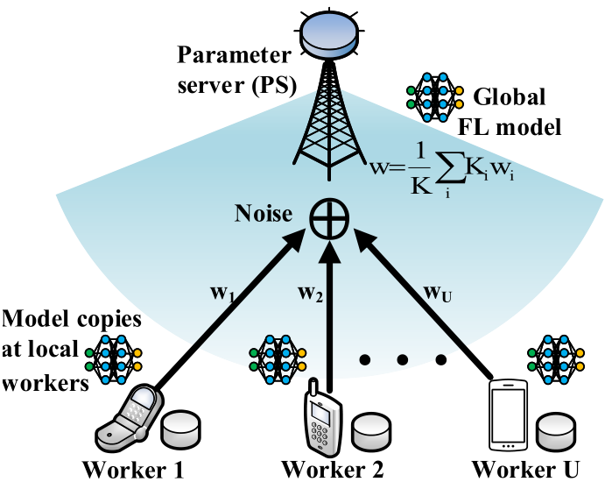


Background - Over-the-Air (OTA)
Parameters Aggregation: Over-the-air^{[1]}
User 1
User 2
…
Multiple Access Channel
U$ser U$
Increase U-time commun. Efficiency
Unreachable local params for server
Expensively rely on orthogonal link resources
Sum comes naturally via analog aggregation
[1] Fan X, Wang Y, Huo Y, et al. Joint optimization of communications and federated learning over the air[J]. IEEE Trans. Wireless Commun., vol. 21, no. 6, pp. 4434-4449, 2021.

Slide 7
Outline
Introduction
Prior works
Proposed design and method
Preliminary results
Summary and future work

Slide 8
Prior works – Non-i.i.d Issue
Non-i.i.d. definition on ML（Dataset shift）
Non-i.i.d:
Covariate shift
Prior probability shift
Concept shift
Non-i.i.d. definition on FL ^{[1]}
Covariate shift (feature distribution skew)
Prior probability shift (label distribution skew)
Concept shift I (same label, different features)
Concept shift II (same feature, different labels)
Quantity skew
[1] Kairouz P, McMahan H B, Avent B, et al. Advances and open problems in federated learning[J]. Foundations and trends® in machine learning, 2021, 14(1–2): 1-210.
Notes:
Covariate shift the distribution is different between train set and test set
Prior probability shift the labels is different between train set and test set
Concept shift the mapping function is different between train set and test set

Slide 9
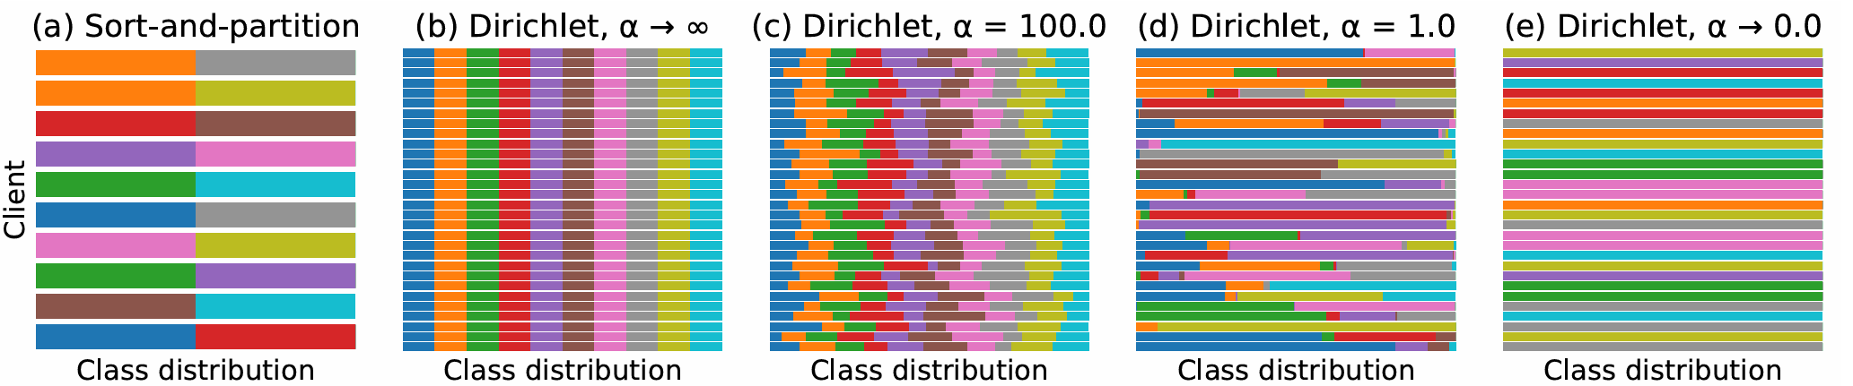
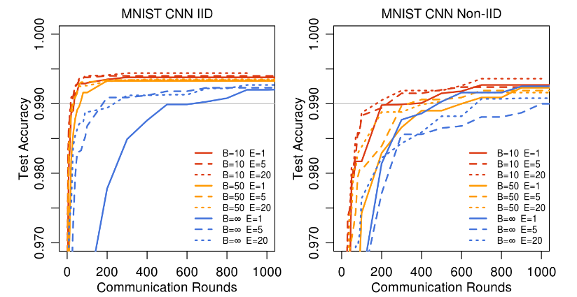
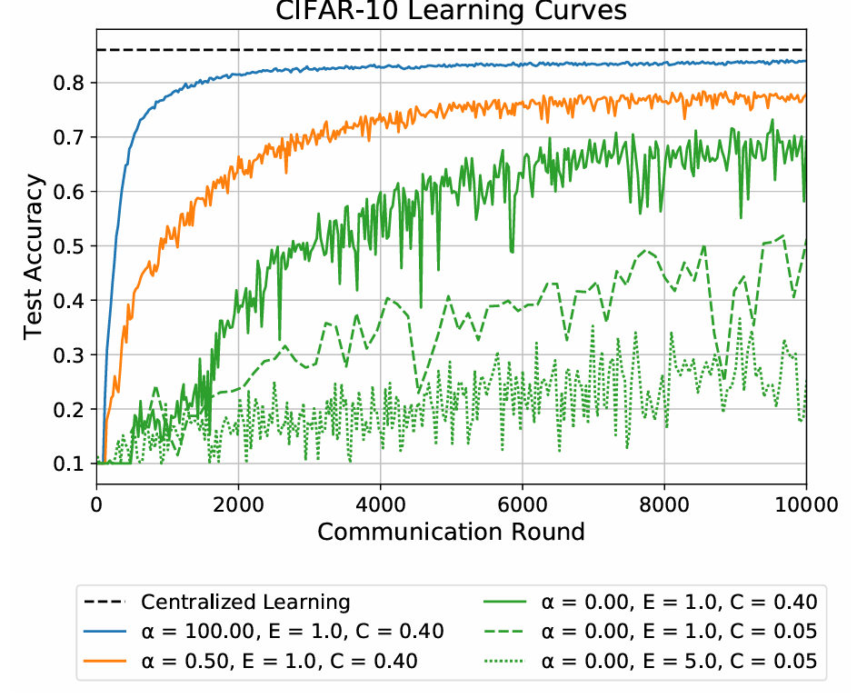
Prior works – Non-i.i.d Generation
Data sampling: Dirichlet distribution^{[1]}
Pathological non-i.i.d. datasets^{[2]}
Digit label sorting
200 shards with 300 samples
Each client randomly select 2 shards
[1] Hsu T M H, Qi H, Brown M. Measuring the effects of non-identical data distribution for federated visual classification[J]. arXiv preprint arXiv:1909.06335, 2019.
[2] McMahan B, Moore E, Ramage D, et al. Communication-efficient learning of deep networks from decentralized data[C]//Artificial intelligence and statistics. PMLR, 2017: 1273-1282.
Notes:
C reporting fraction

Slide 10
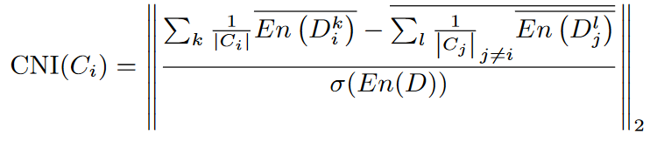
Prior works – Non-i.i.d Metrics
Model-based
Wight divergence^{[1]}
Data skew^{[2]}
Client-Wise Non-IID Index^{[3]}
Data-based
Heterogeneity Index^{[4]}
Imbalance Ratio^{[5]}
[1] Zhao Y, Li M, Lai L, et al. Federated learning with non-iid data[J]. arXiv preprint arXiv:1806.00582, 2018.
[2] Haller M, Lenz C, Nachtigall R, et al. Handling non-iid data in federated learning: An experimental evaluation towards unified metrics[C]//2023 IEEE Intl Conf on Dependable, Autonomic and Secure Computing, Intl Conf on Pervasive Intelligence and Computing, Intl Conf on Cloud and Big Data Computing, Intl Conf on Cyber Science and Technology Congress (DASC/PiCom/CBDCom/CyberSciTech). IEEE, 2023: 0762-0770.
[3] Li A, Sun J, Wang B, et al. Lotteryfl: Personalized and communication-efficient federated learning with lottery ticket hypothesis on non-iid datasets[J]. arXiv preprint arXiv:2008.03371, 2020.
[4] Zawad S, Ali A, Chen P Y, et al. Curse or redemption? how data heterogeneity affects the robustness of federated learning[C]//Proceedings of the AAAI conference on artificial intelligence. 2021, 35(12): 10807-10814.
[5] Wen H, Wu Y, Hu J, et al. Communication-efficient federated learning on non-IID data using two-step knowledge distillation[J]. IEEE Internet of Things Journal, 2023, 10(19): 17307-17322.

Slide 11
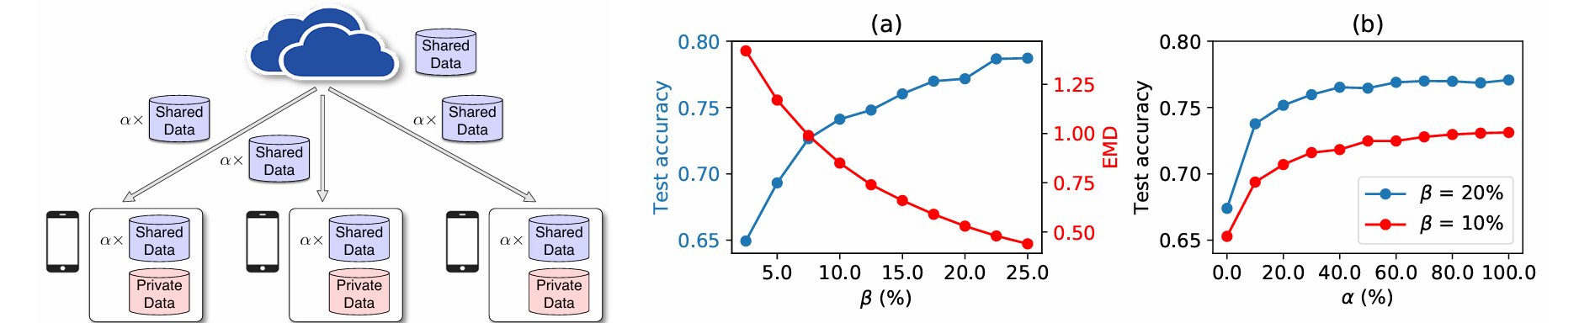
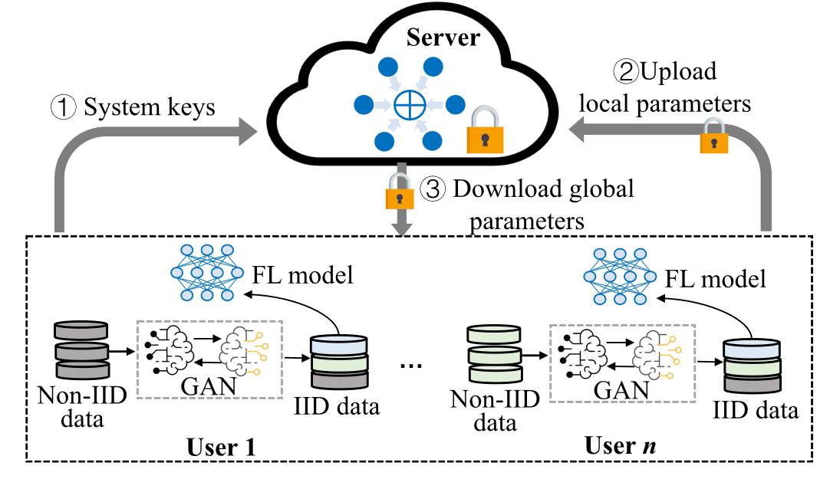
Prior works – Non-i.i.d FL
Solutions: Data sharing & enhancement.
The accuracy can be increased by 30% with only 5% globally shared data. ^{[1]}
GANs can release the privacy concern of sharing data^{[2]}
[1] Zhao Y, Li M, Lai L, et al. Federated learning with non-iid data[J]. arXiv preprint arXiv:1806.00582, 2018.
[2] Ma Z, Liu Y, Miao Y, et al. Flgan: Gan-based unbiased federated learning under non-iid settings[J]. IEEE Transactions on Knowledge and Data Engineering, 2023, 36(4): 1566-1581.

Slide 12


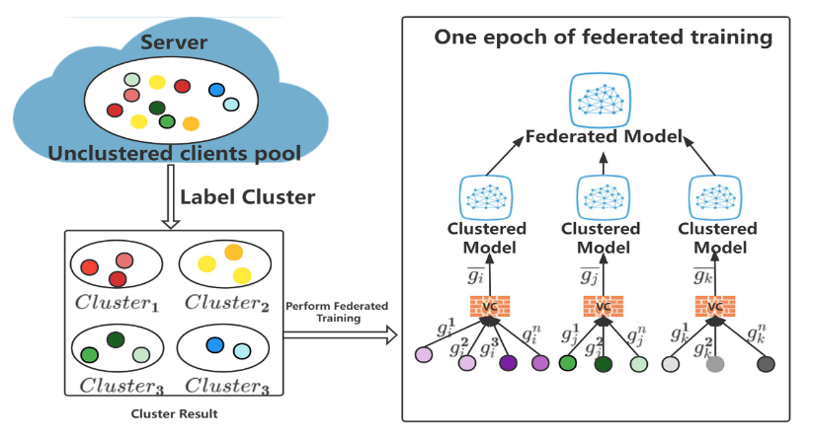
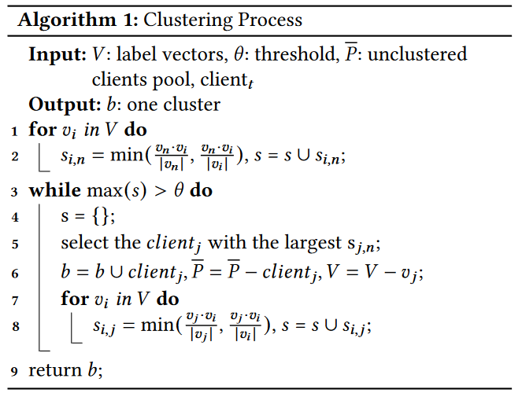
Existing research – Non-i.i.d FL
Solutions: Clustering clients
Cominer FL^{[1]}: Label Cluster + Vertical Comparison
Data similarity
Threshold :based on Datasets.
[1] Zou H, Zhang Y, Que X, et al. Efficient federated learning under non-IID conditions with attackers[C]//Proceedings of the 1st ACM Workshop on Data Privacy and Federated Learning Technologies for Mobile Edge Network. 2022: 13-18.

Slide 13
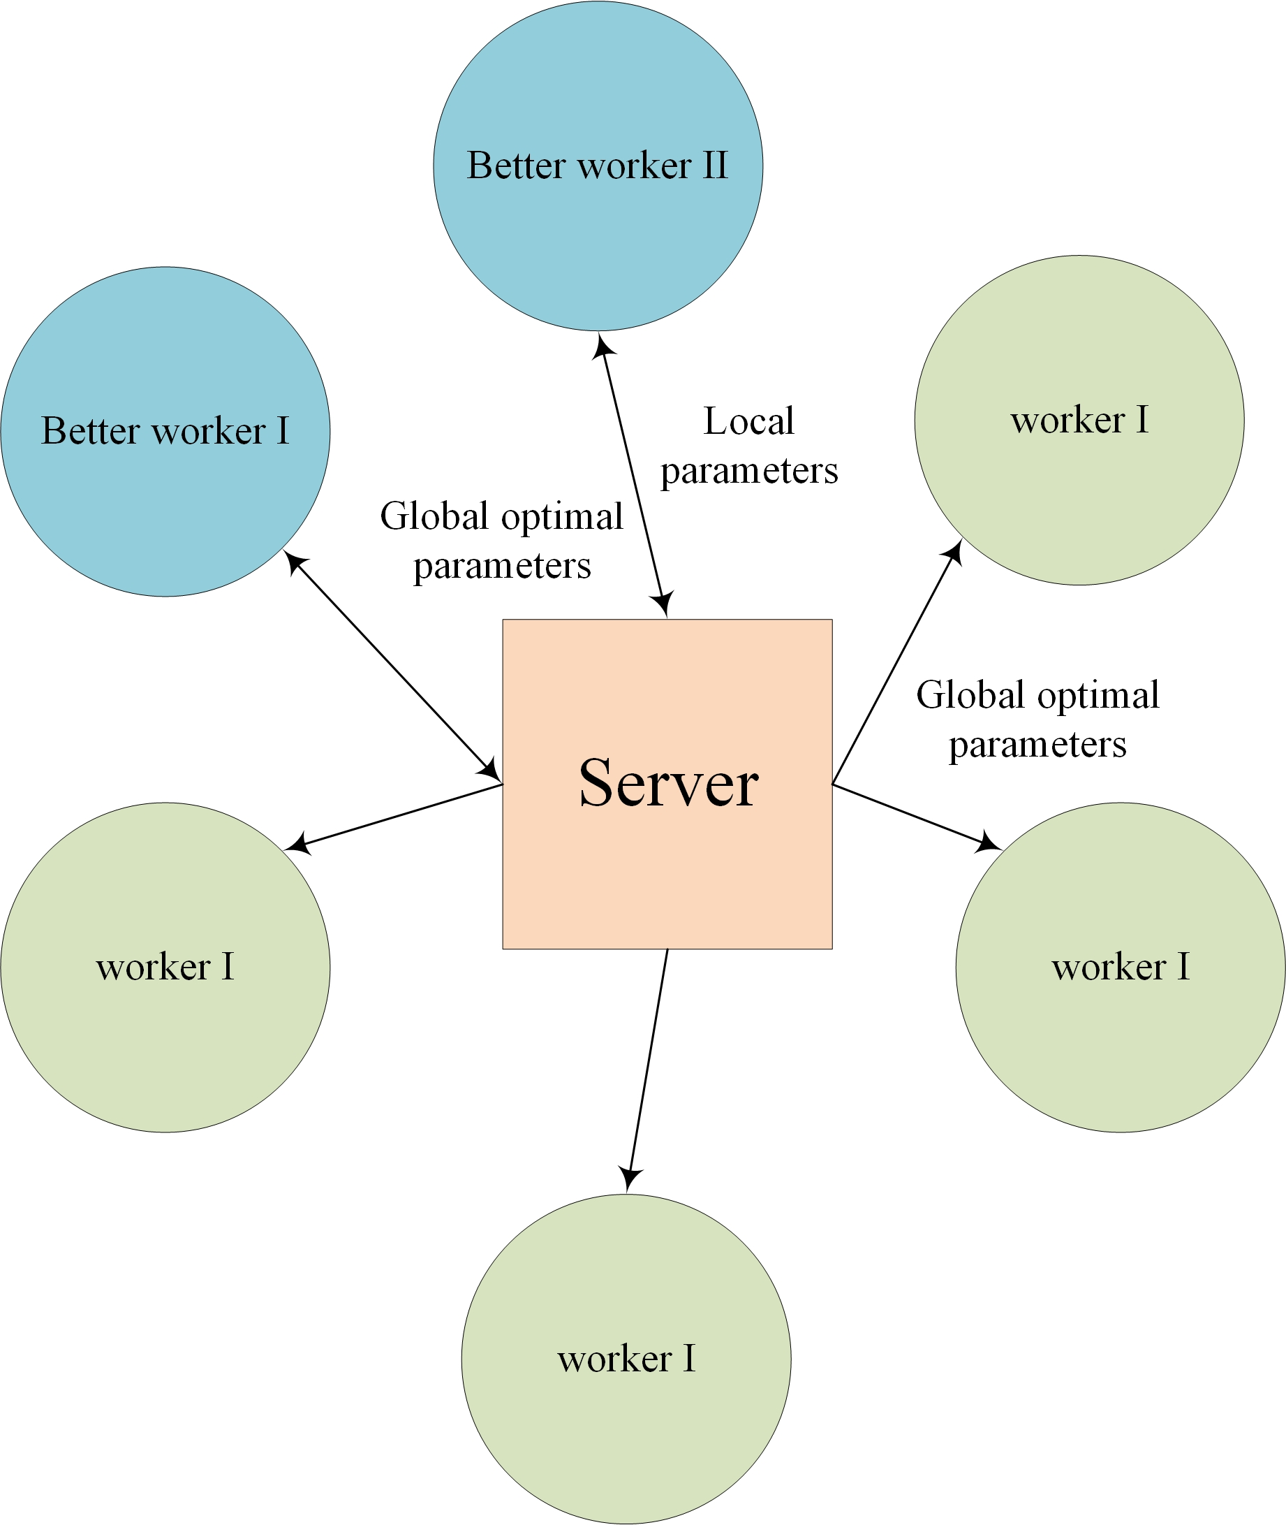
Prior works – Non-i.i.d DSL
Solutions: Distributed Swarm Learning^{[1]} =SGD + PSO
 | PSO | DSL | FL
Commun. | low (U func. values + 1 model) | low (U func. values + S model) | High (U models)
Computation | zero-th order | first order | first order
Convergence | slow | fast | fast
Trap escape | capable | capable | unable
Model structure
[1]Wang Y, Tian Z, Fan X, Cai Z., et al. Distributed swarm learning for edge internet of things[M]. IEEE Communications Magazine, 2024.
Notes:
The researcher summarize the pros and cons of FL and PSO, try to use both of them to solve distributed problems. The original DSL structure is as the right image. Differ from the federated learning, DSL has some better worker group, this group is different in each communication round. Only better worker could upload param.

Slide 14
Outline
Introduction
Existing research
Proposed design and method
Preliminary results
Summary and future work

Slide 15
Challenges and Motivation
Problems in existing distributed swarm learning framework
Lack of non-i.i.d. metrics
Best worker selection mechanism Ideal Comm. Env.
Q: How to make DSL more communication efficient and more non-i.i.d. tolerant?
Solutions: Distributed Swarm Learning with Over-the-air (DSL-OTA)
How to measure the non-i.i.d. degree of datasets
How to transmit model?
How to select better workers?
Weighted Wasserstein Distance
Over-the-air Aggregation
Joint Optimization

Slide 16
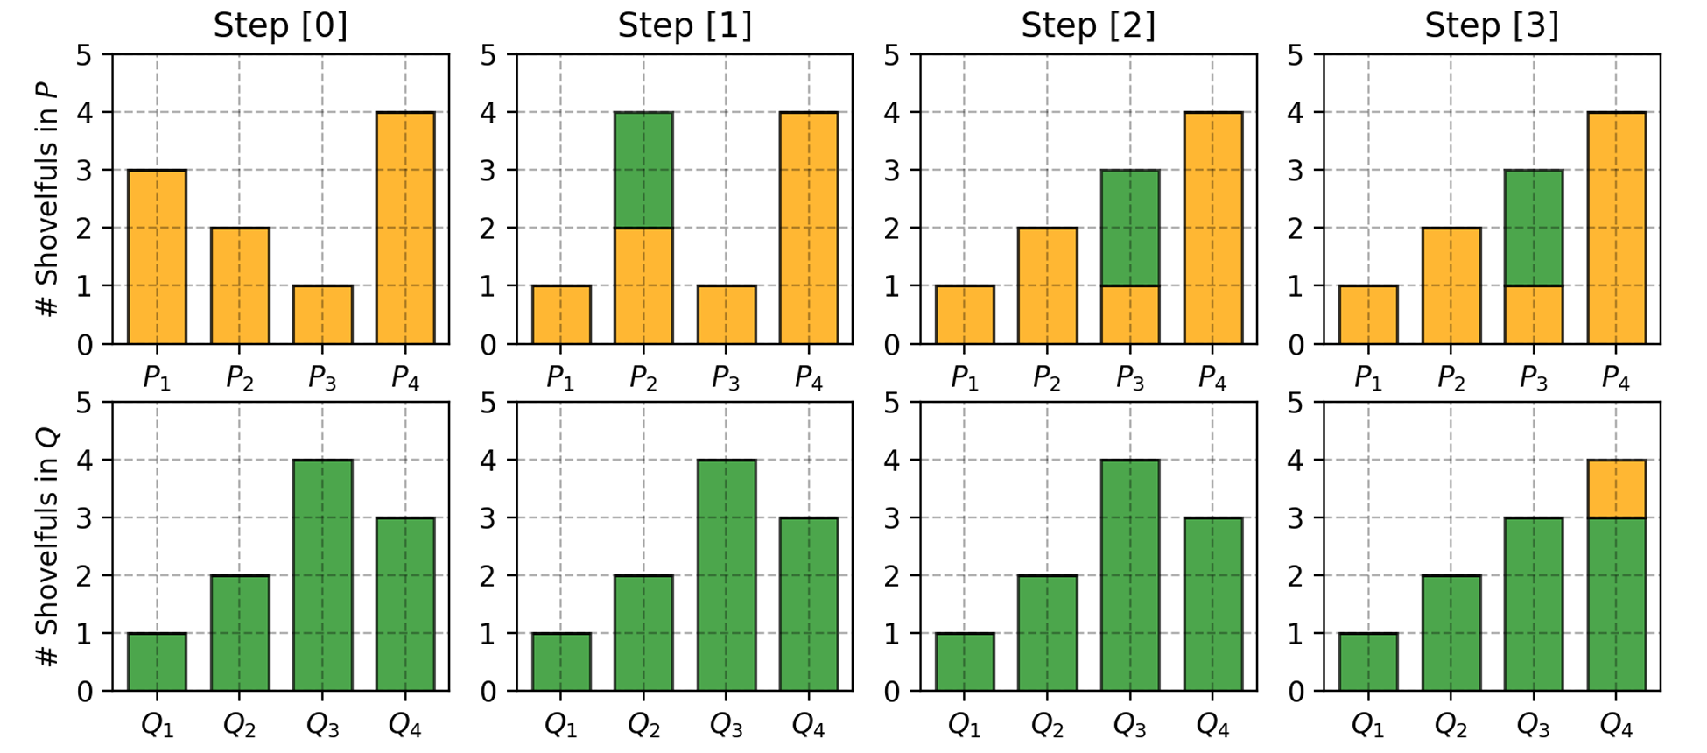
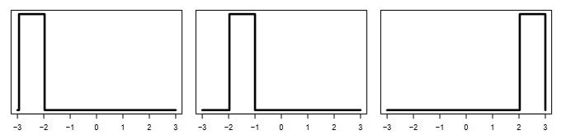
Proposed Method: Non-i.i.d. Metric
Wasserstein distance (Earth Mover’s Distance)
The minimal cost of transforming one distribution to the other.
Why Wasserstein distance? Why not KL, JS distance?
Provide smoother for parameter updating.
Can solve non-overleaping distribution problems.
[1] Weng L. From gan to wgan[J]. arXiv preprint arXiv:1904.08994, 2019.
[2] Lv J, Yang H, Li P. Wasserstein Distance Rivals Kullback-Leibler Divergence for Knowledge Distillation[J]. Advances in Neural Information Processing Systems, 2025, 37: 65445-65475.

Slide 17
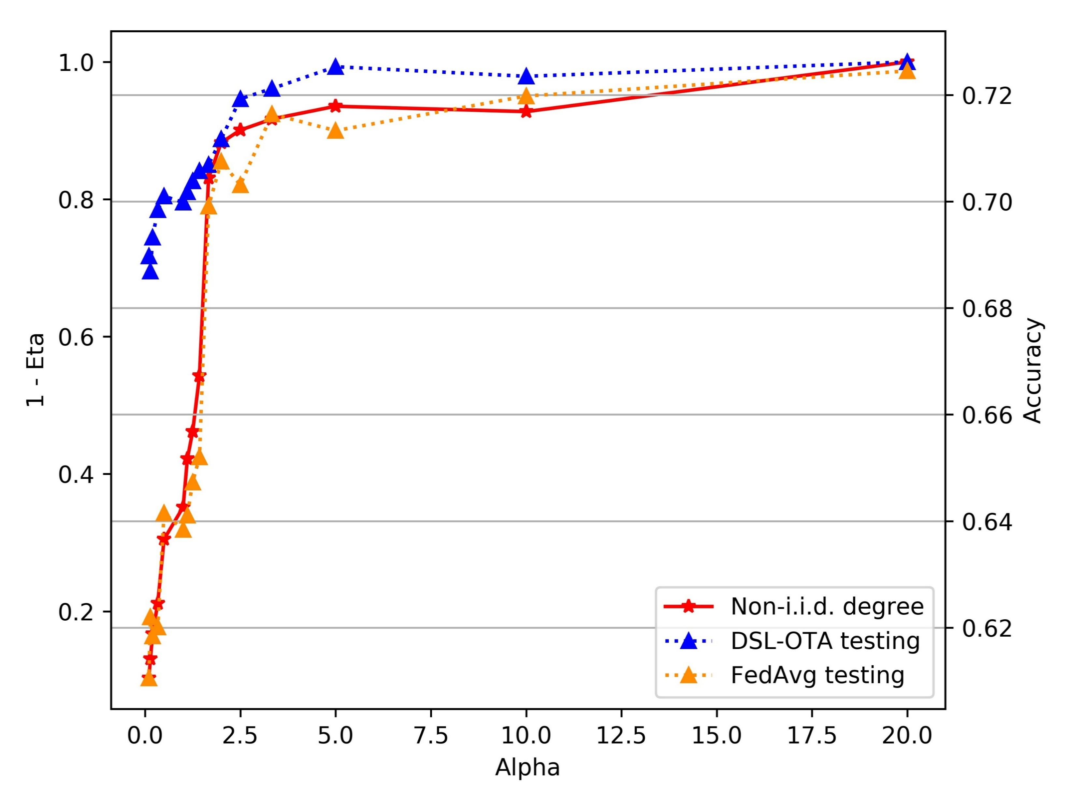
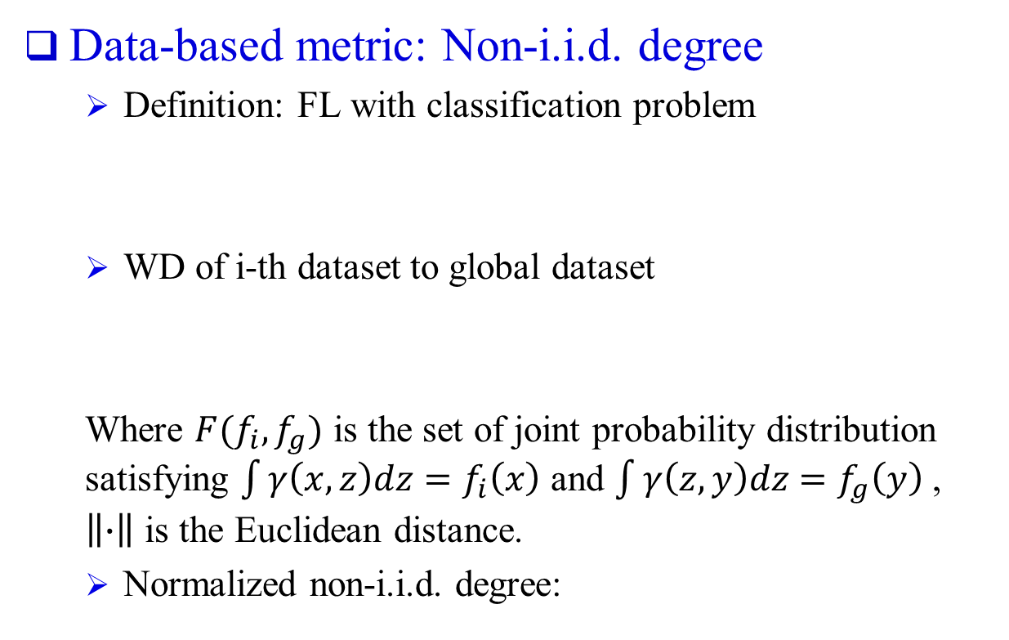
Proposed Method: Non-i.i.d. Metric
Data-based metric: Non-i.i.d. degree
Definition: FL with classification problem
WD of i-th dataset to global dataset
Where $F(f_{i},f_{g})$ is the set of joint probability distribution satisfying $\int{γ\left(x,z\right)dz}=f_{i}\left(x\right)$ and $\int{γ\left(z,y\right)dz}=f_{g}\left(y\right)$ , $\left\|∙\right\|$ is the Euclidean distance.
Normalized non-i.i.d. degree:
Low non-i.i.d. degree means more labels and more balanced distribution

Slide 18
Proposed Method: DSL-OTA
OTA: to enhance model aggregation
Signal Transmission
Received signal:
Recognizable transmitting power constraint:
Received sum parameter:
Estimated signal:
Increase U-time commun. Efficiency
Unreachable local params for server
[1] Fan X, Wang Y, Huo Y, et al. Joint optimization for federated learning over the air[C]//ICC 2022-IEEE International Conference on Communications. IEEE, 2022: 2798-2803.
Notes:
H channel vector, b transmitter scalar, m receiver beam forming vector

Slide 19
Proposed Method: DSL-OTA
Adaptive multi-worker selection: Joint-optimization
Target: select more workers for collaboration learning
Constrain: reachable signal, high quality local data, better accuracy score.
Strategy: adaptive optimization
Lagrangian
Argument Relaxation

Slide 20
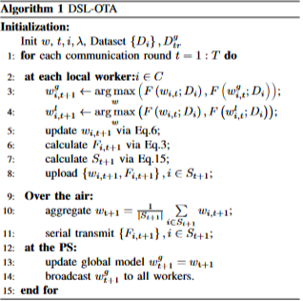
Proposed Method: DSL-OTA
DSL-OTA Algorithm

Slide 21
Outline
Introduction
Existing research
Proposed design and method
Preliminary results
Summary and future work

Slide 22
Experiments-Setups
Task: Word-level language modeling
Datasets & Models: MNIST (CNN); CIFAR-10 (ResNet18)
Framework setup:
50 workers with 500 images locally, 1 Parameter sever with 2000 images.
Wireless environments simulations: time-invariant transmit power and channel

Slide 23
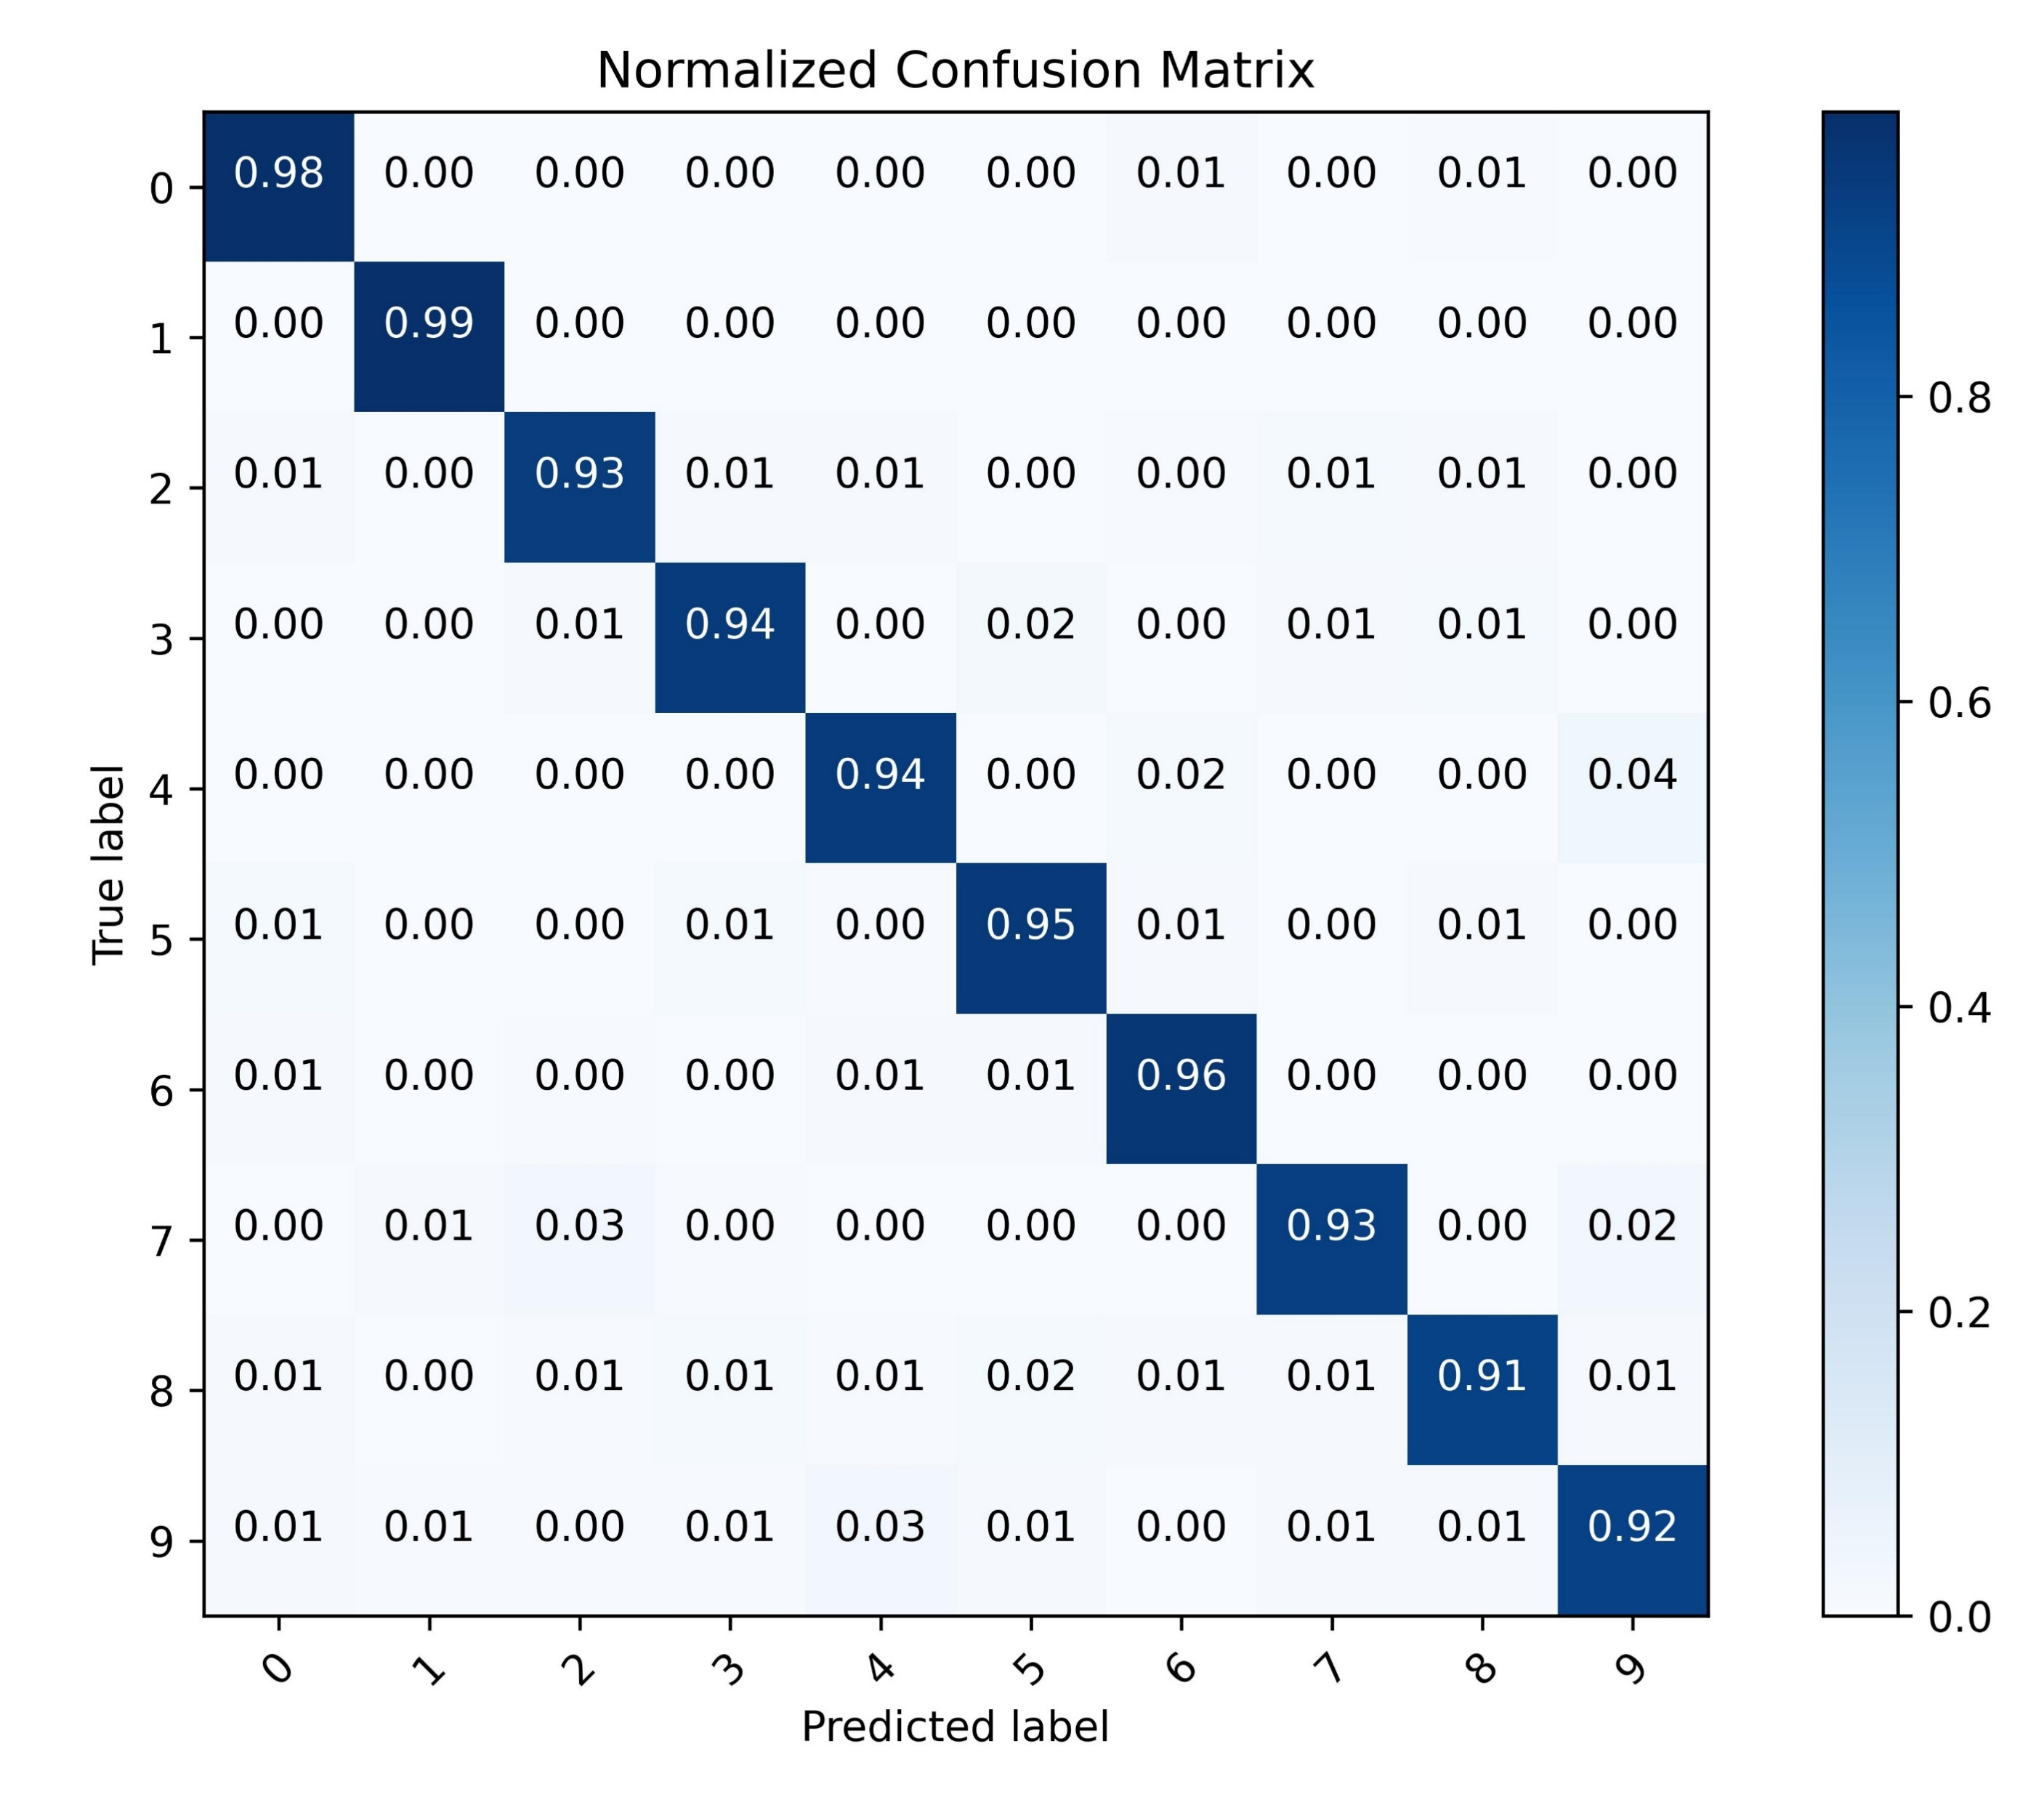
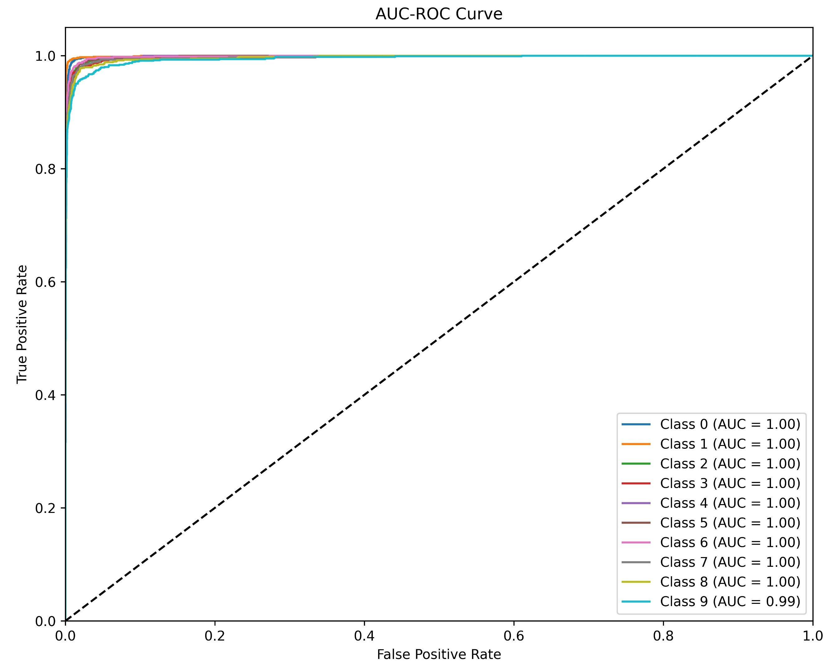
Experiments-Main Results
Classification matrix of DSL-OTA.
MNIST AUC-ROC Curve
MNIST confusion matrix

Slide 24
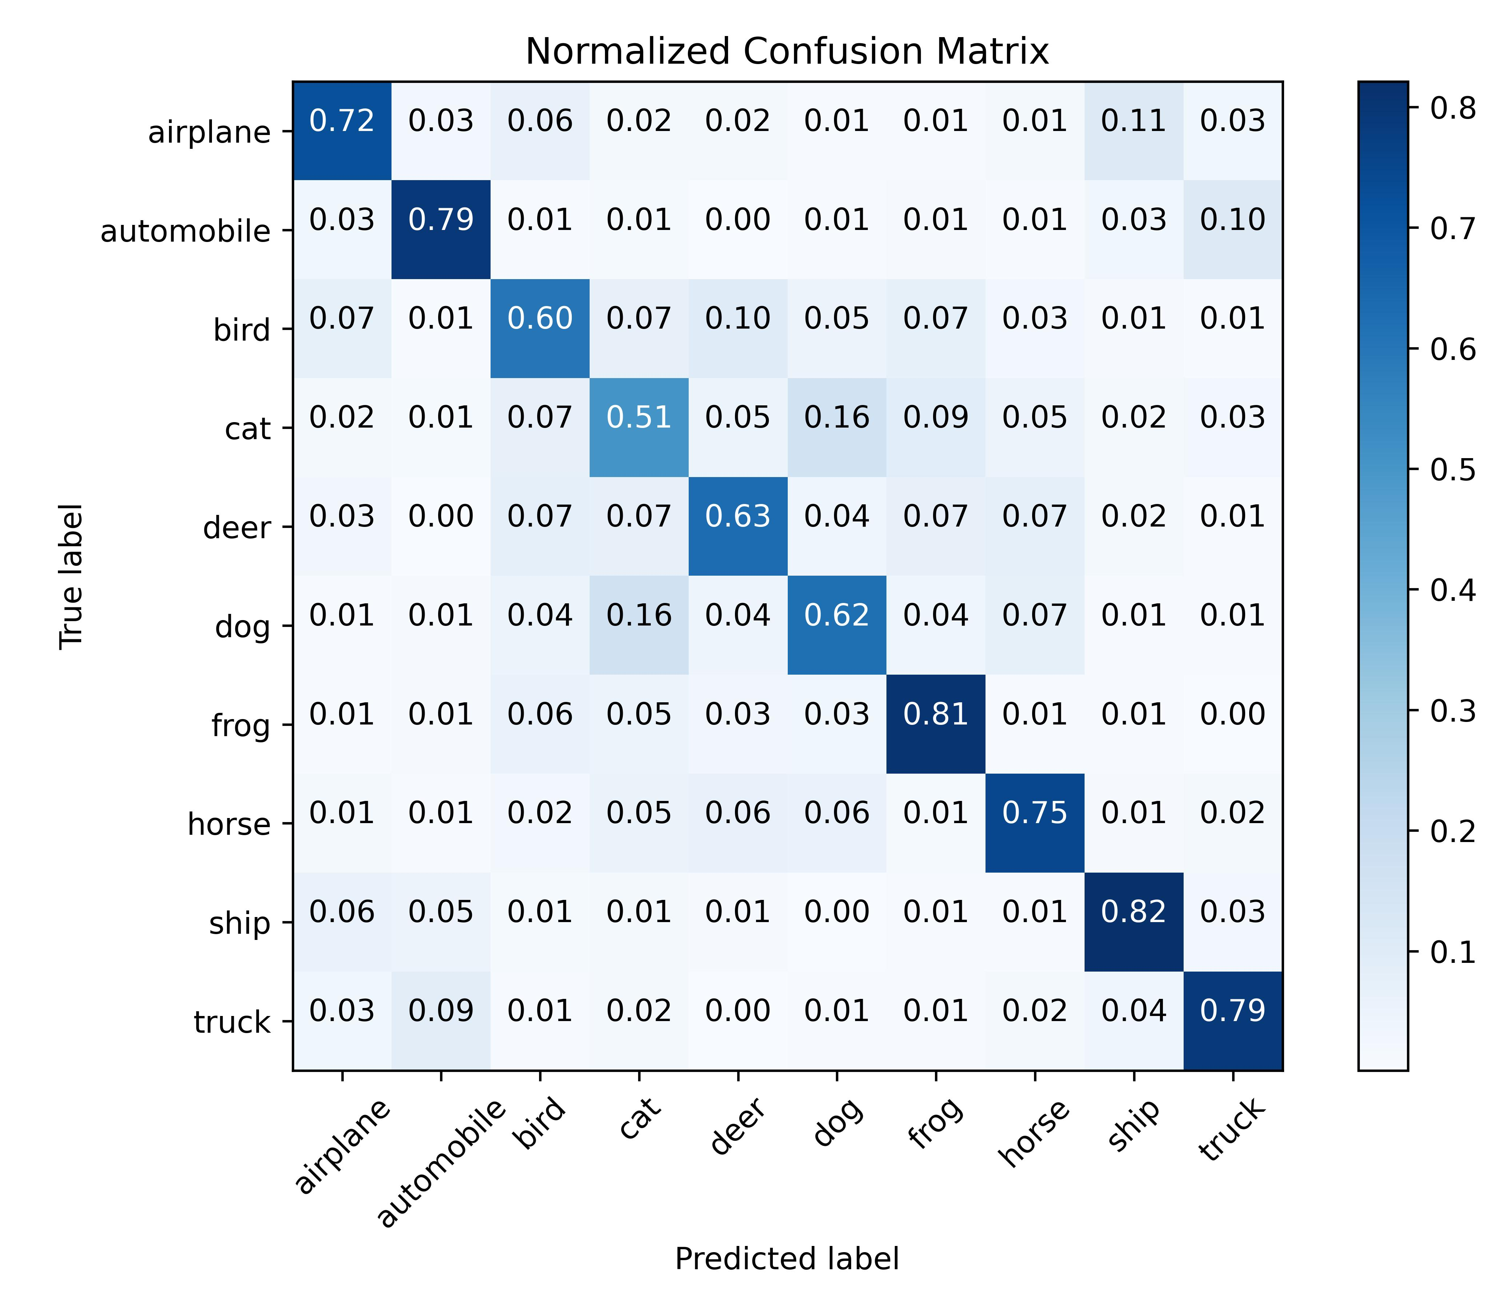
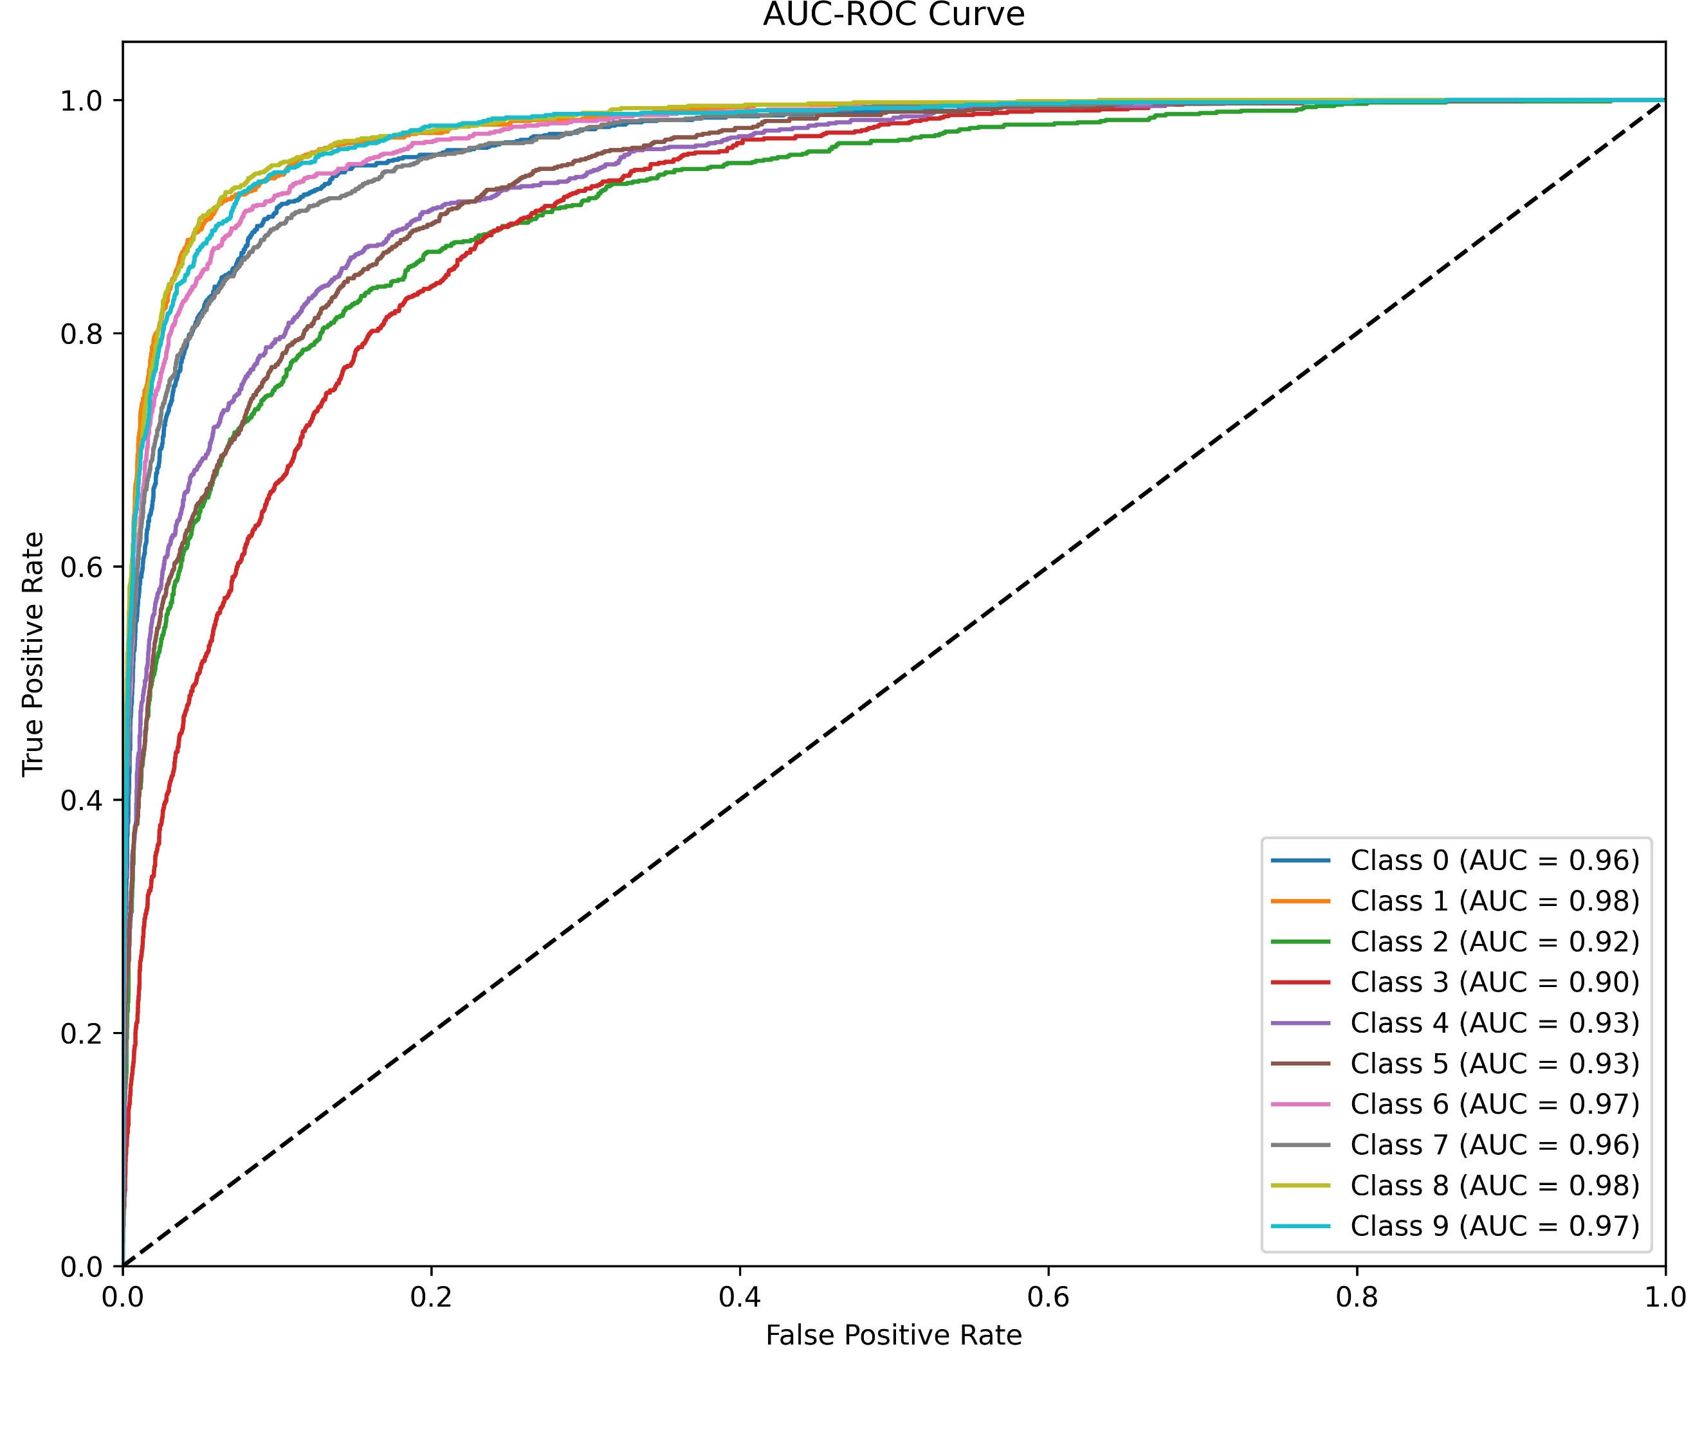
Experiments-Main Results
Classification matrix of DSL-OTA.
CIFAR10 AUC-ROC Curve
CIFAR10 confusion matrix

Slide 25
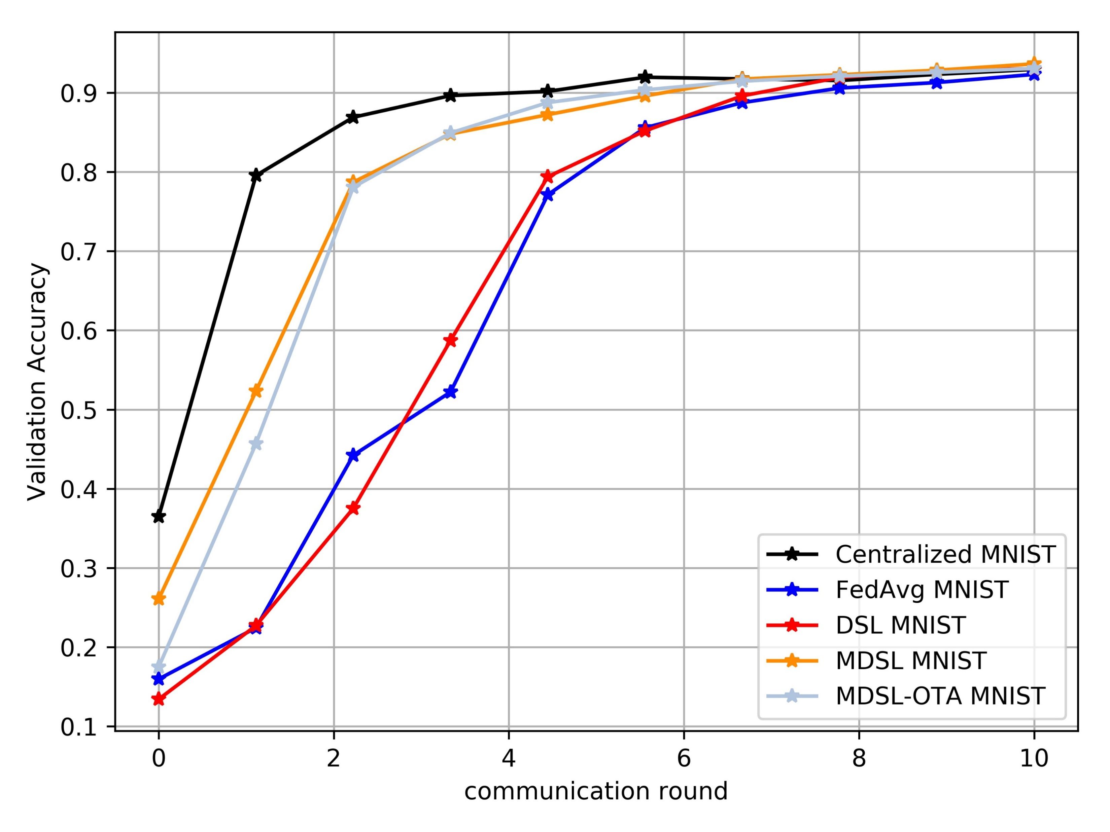
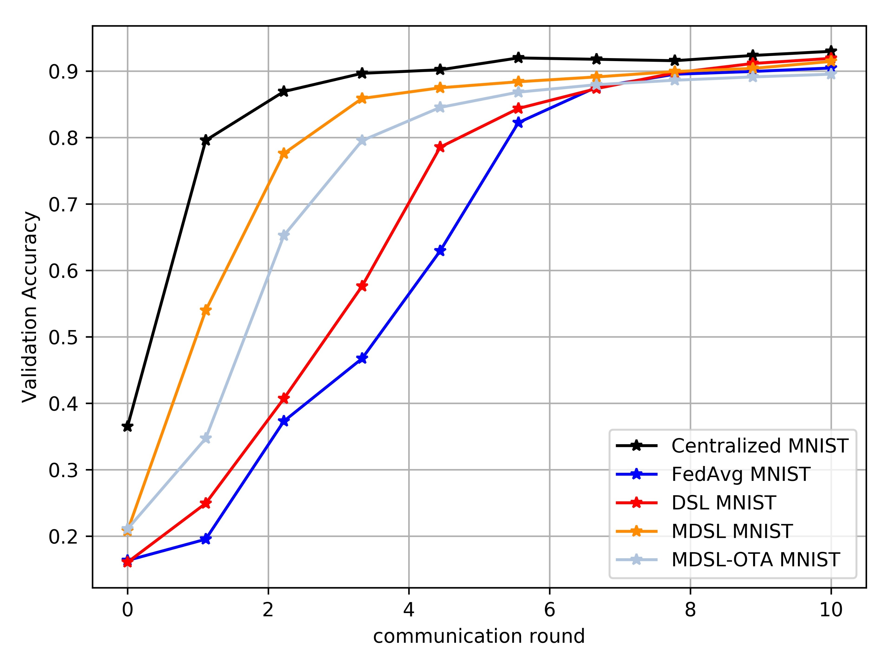
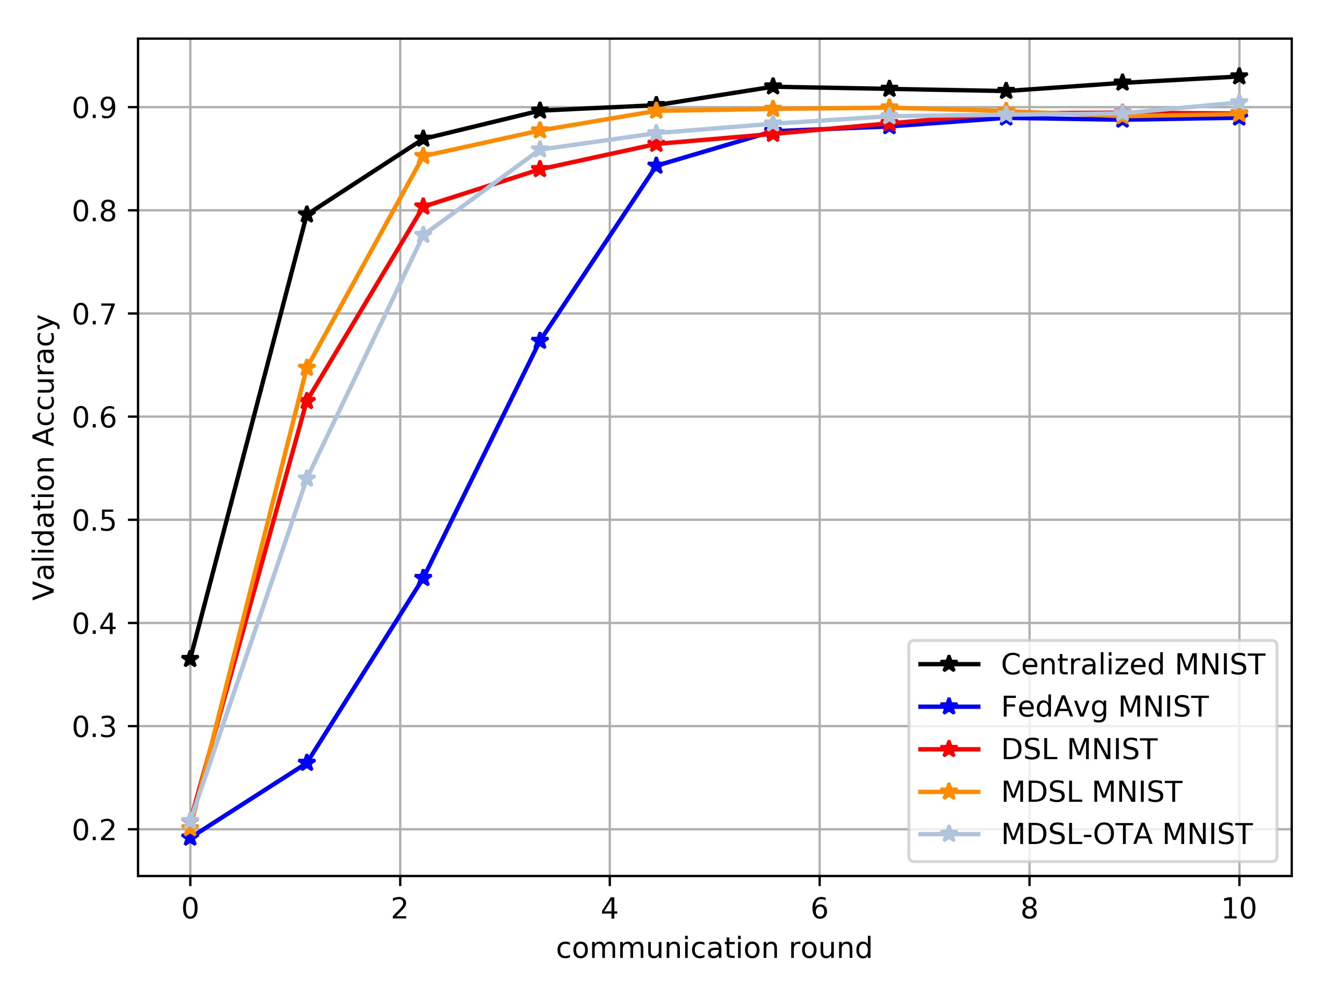
Experiments-Comparable Experiments
Models with different Non-i.i.d. degree on MNIST

Slide 26
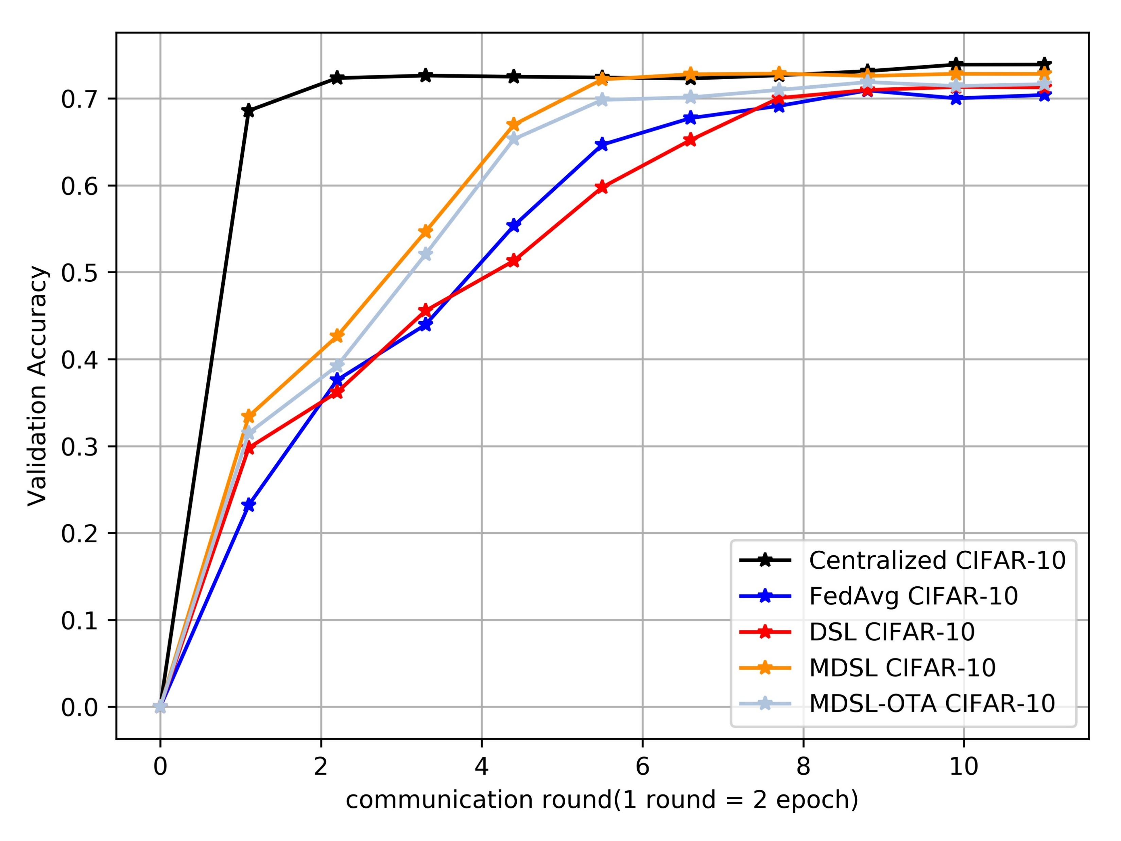
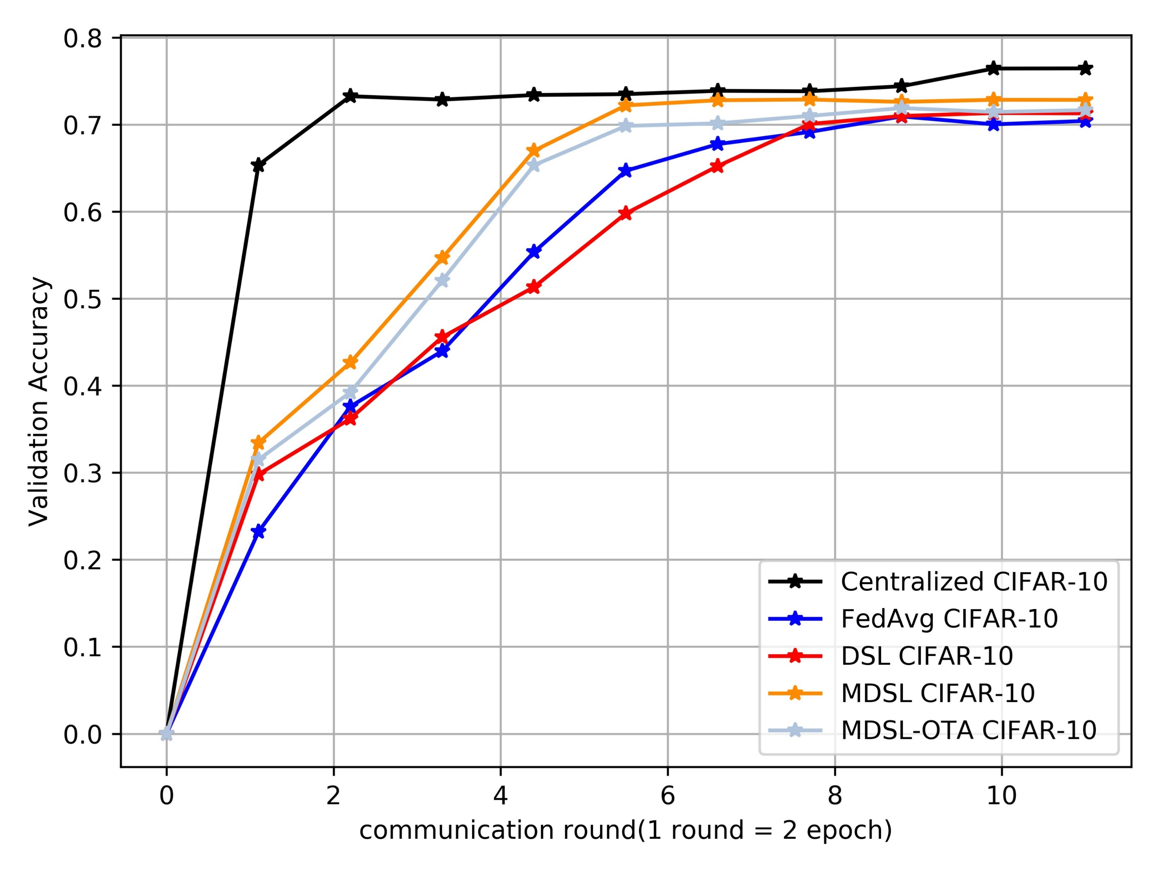
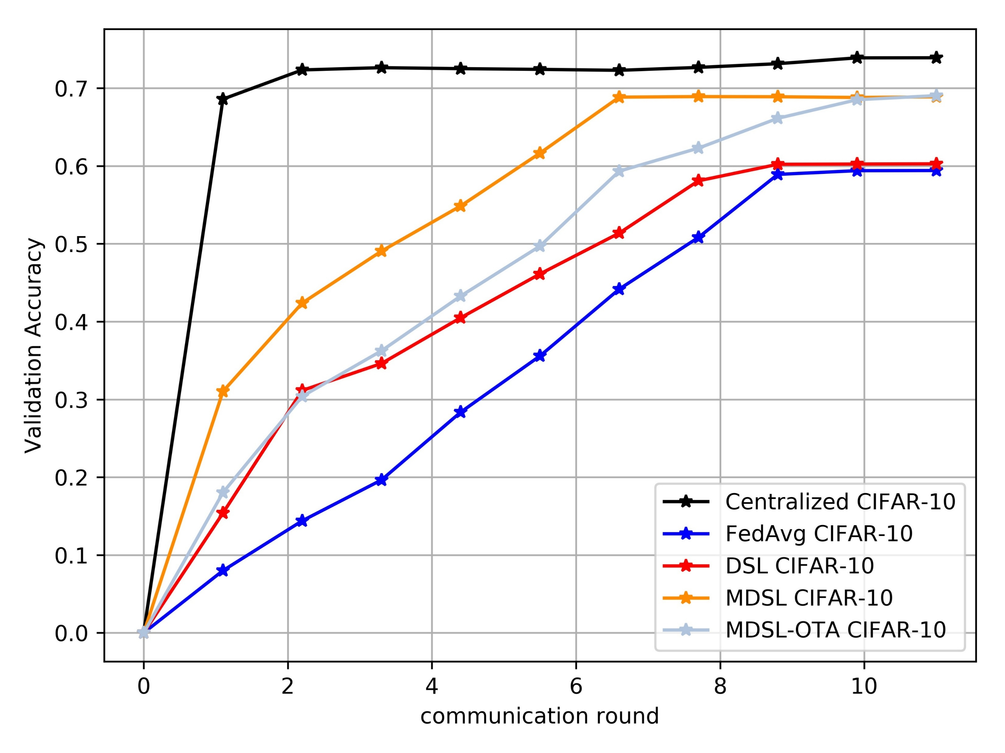
Experiments-Comparable Experiments
Models with different Non-i.i.d. degree on CIFAR10

Slide 27
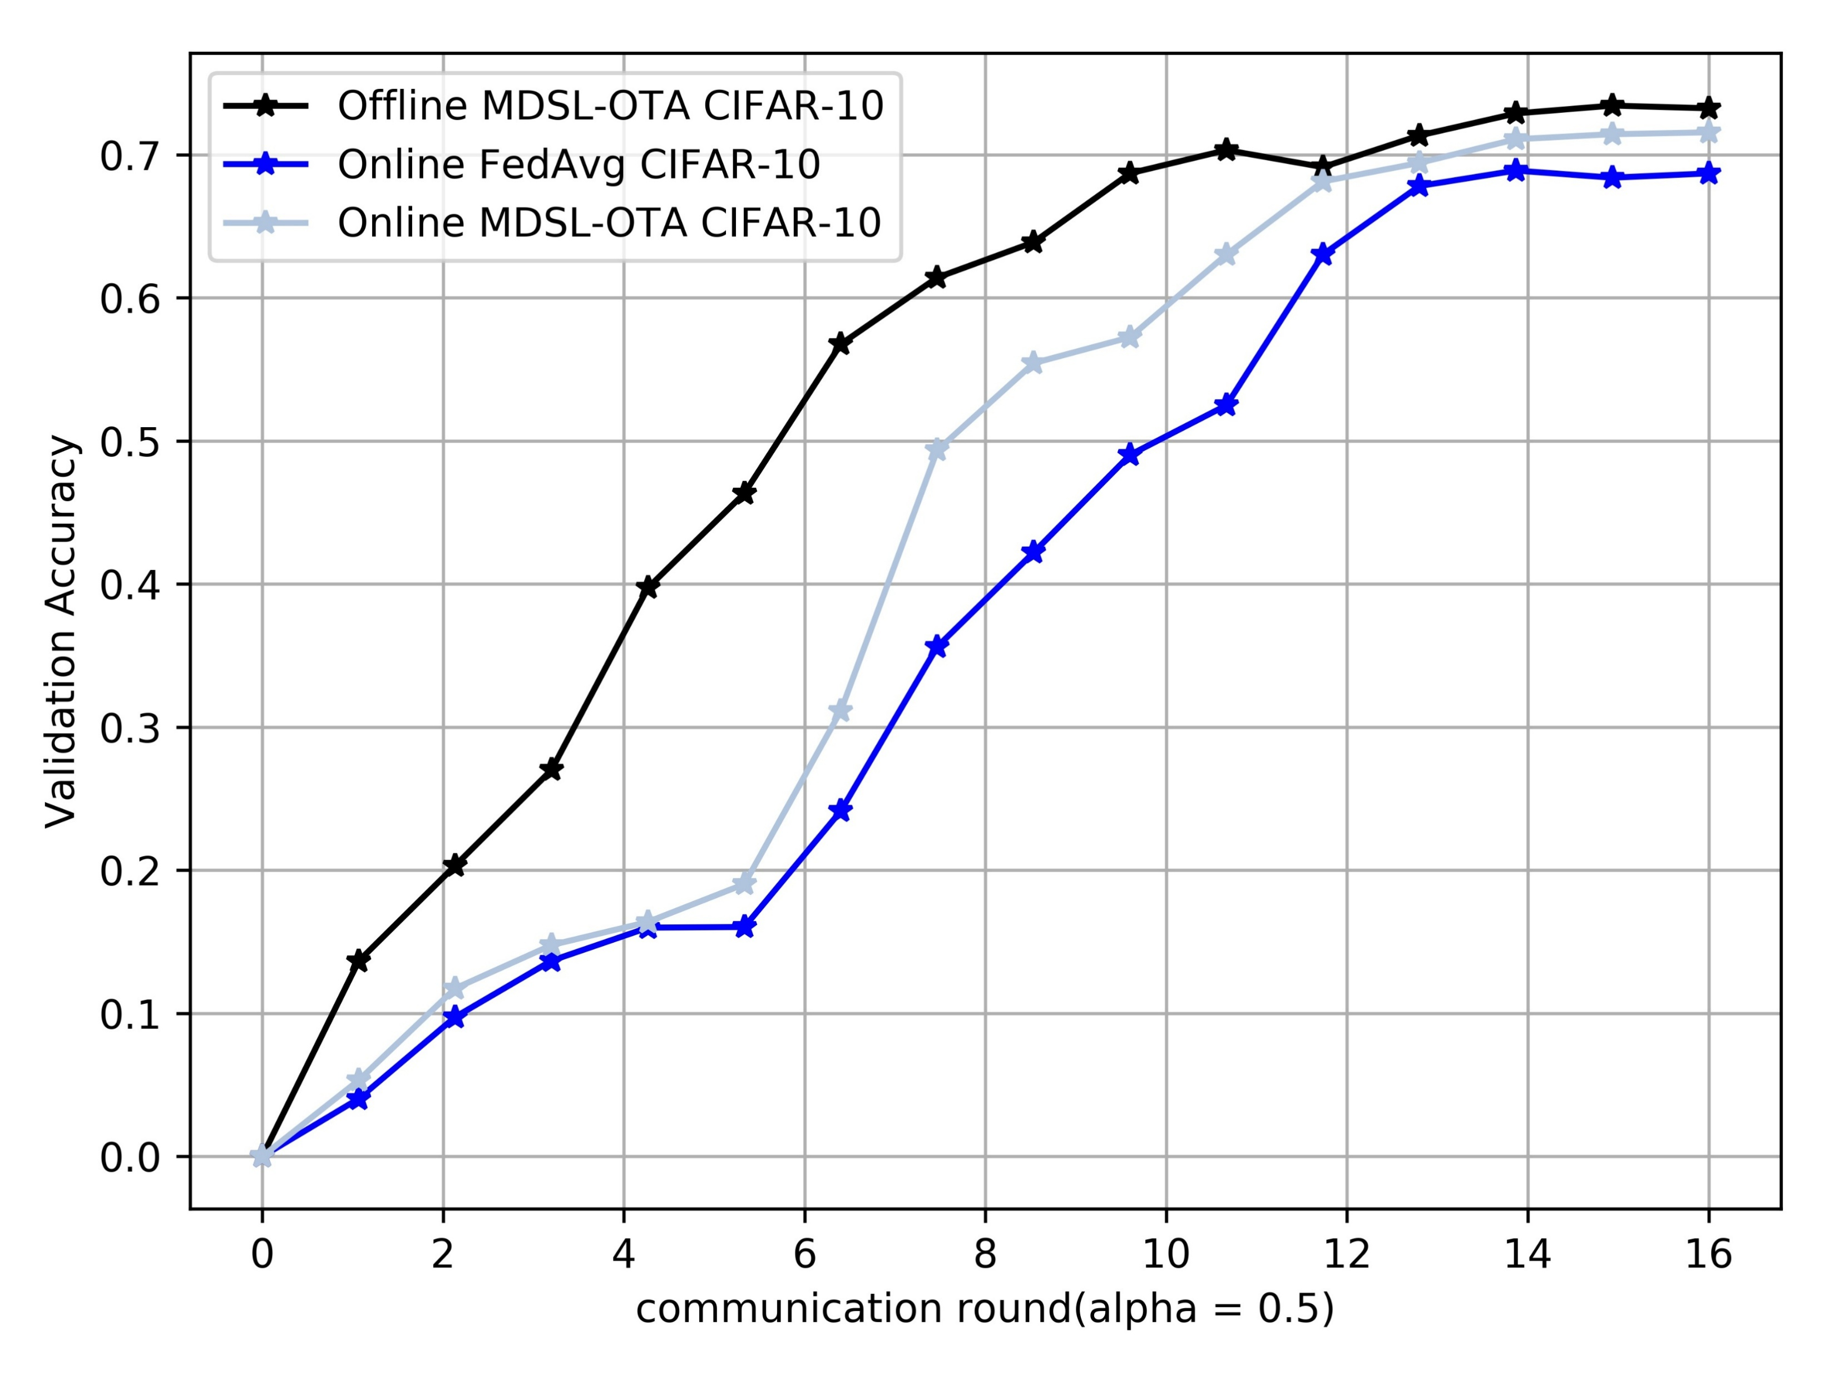
Experiments-Online Learning
What if streaming data?
Environment setup: CIFAR-10,
Online data input: (1 Communication Round=5 epoch)
First five CR: add 100 images to local datasets in each CR.
Offline data input:
Local datasets have 500 images initially.
✗
Streaming data have same distributions

Slide 28
Outline
Introduction
Existing research
Proposed design and method
Preliminary results
Summary and future work

Slide 29
Summary
DSL-OTA with non-i.i.d. data
Adaptive optimization: PSO & multi-worker selection strategy to fully utilize local datasets.
Model aggregation: OTA enhance the communication efficiency.
Non-i.i.d. metric: propose a data-based metric for the heterogeneity of datasets.
Further study:
Non-i.i.d. scenario: quantity skew & streaming input
Dynamic systems: time-varying workers and environment
Decentralized systems: no PS, better privacy

Slide 30
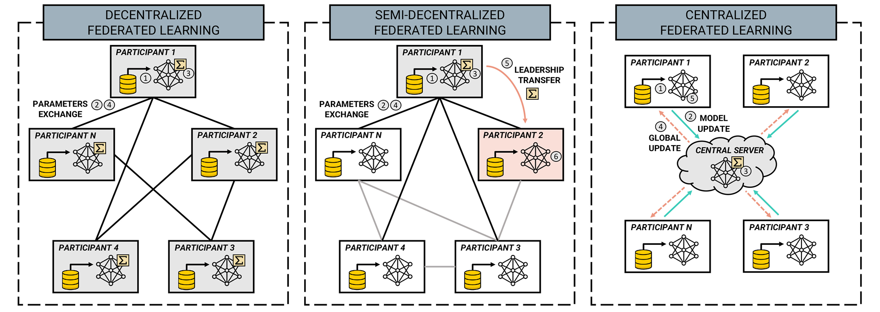
Future Work –Decentralized DSL
Decentralized DSL ^{[1]}
Robustness, trustworthy, efficiency commun.
Affiliation of better workers: Graph Theory
[1] Beltrán E T M, Pérez M Q, Sánchez P M S, et al. Decentralized federated learning: Fundamentals, state of the art, frameworks, trends, and challenges[J]. IEEE Communications Surveys & Tutorials, 2023.

Slide 31
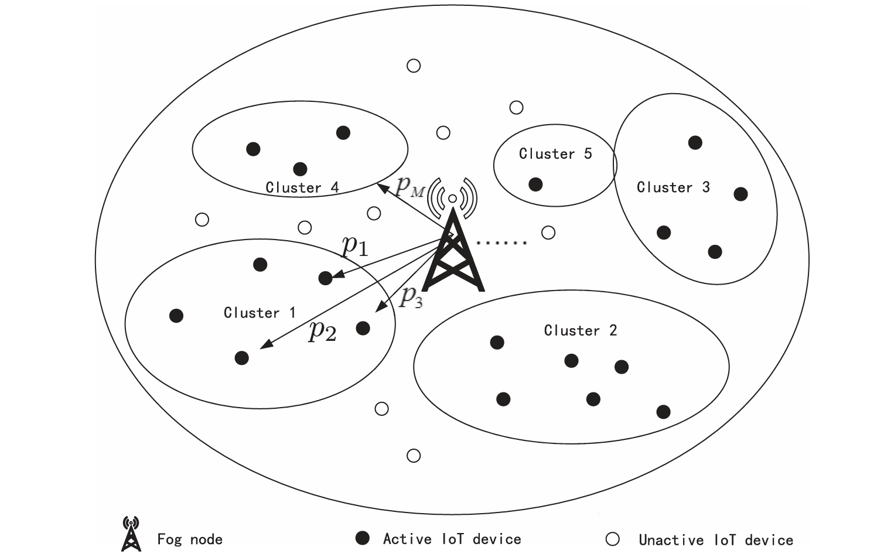
Future Work – Dynamic DSL
Dynamic devices & datasets
Dynamic Systems ^{[1]}
Time-varying channel
Time-varying power
Streaming Data ^{[2]}
Data drift
Concept drift
✗
✗
User-perceived latency
Optimizer Failure
✗
✗
Energy management
Model degradation
✗
Privacy concern
Drift detection
Novel backward propagation
Adaptive learning
Mobile edge computing
Offloading strategy
Adaptive optimization
[1] Shao X, Yang C, Chen D, et al. Dynamic IoT device clustering and energy management with hybrid NOMA systems[J]. IEEE Transactions on Industrial Informatics, 2018, 14(10): 4622-4630.
[2] Tegin B, Duman T M. Federated learning with over-the-air aggregation over time-varying channels[J]. IEEE Transactions on Wireless Communications, 2023, 22(8): 5671-5684.

Slide 32
Thank You!

Slide 33
Prior works – Non-i.i.d Issue
Non-i.i.d. definition on ML（Dataset shift）
Learning target of classification:
Covariate shift
Prior probability shift
Concept shift
Non-i.i.d. definition on FL ^{[1]}
Covariate shift (feature distribution skew)
Prior probability shift (label distribution skew)
Concept shift I (same label, different features)
Concept shift II (same feature, different labels)
Quantity skew
Generalization
[1] Kairouz P, McMahan H B, Avent B, et al. Advances and open problems in federated learning[J]. Foundations and trends® in machine learning, 2021, 14(1–2): 1-210.
Notes:
Covariate shift the distribution is different between train set and test set
Prior probability shift the labels is different between train set and test set
Concept shift the mapping function is different between train set and test set

